Slide 1




The Tradeoff between Privacy and Personalization
Mike Nguyen
Mina Ameri
Vanitha Swaminathan

Slide 2
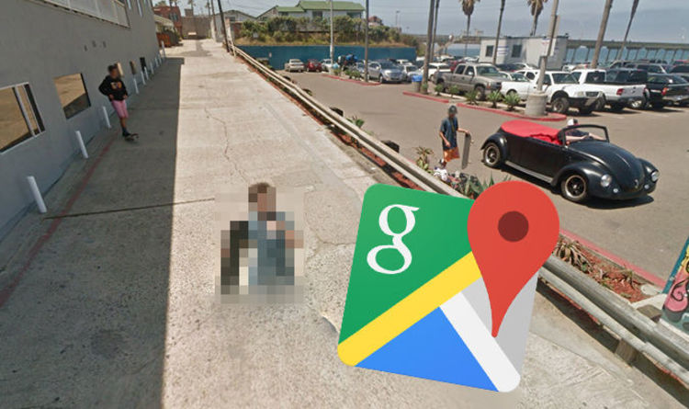
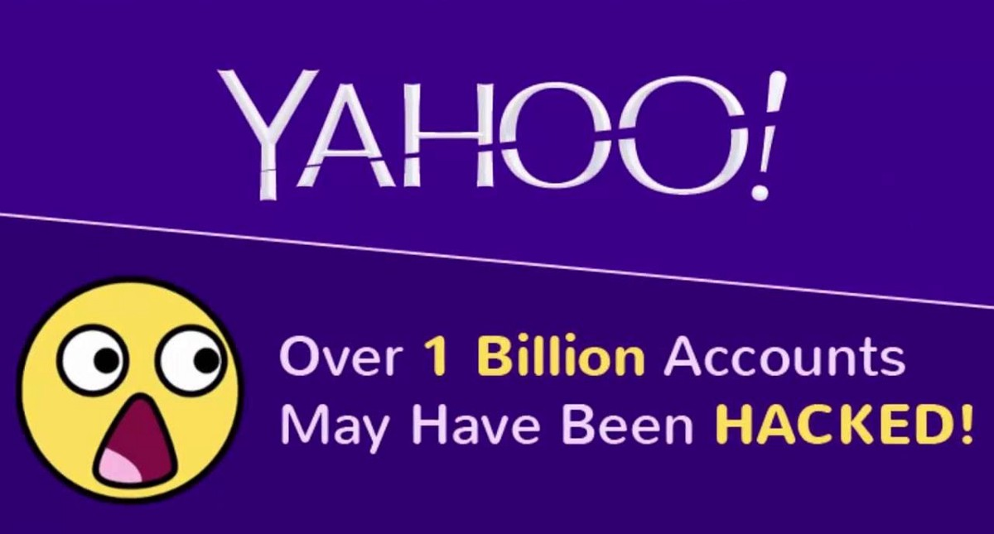




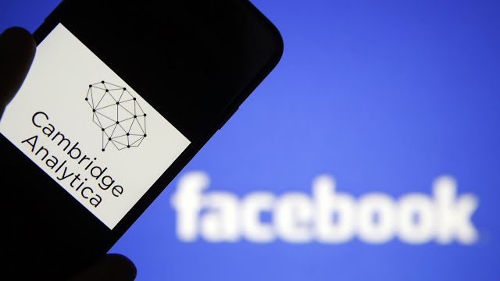
Data Security and Privacy Concerns
2010
2013-2014
2017
2018
2015
2016
2018
This Photo by Unknown Author is licensed under CC BY-SA
This Photo by Unknown Author is licensed under CC BY-SA
This Photo by Unknown Author is licensed under CC BY-NC
Notes:
As we delve into this topic, it's important to remember that data breaches and privacy scandals are not uncommon in today's digital age. To illustrate this point, let's take a look at some of the most notable scandals of the past decade.
There are many scandals regarding major data breaches and privacy violations that exposed personal information of millions of individuals. The breaches compromised sensitive data such as names, addresses, email addresses, Social Security numbers, and birth dates, raising significant concerns about data security and privacy protection. They emphasize the importance of robust security measures, proper data handling practices, and the need for stronger regulations to safeguard personal information in the digital age.
Google Street View: In 2010, Google's Street View cars had been collecting personal information from unsecured WiFi networks, including emails and passwords.
Anthem Data Breach: In 2015, Anthem suffered a data breach in which personal information of 80 million customers, including Social Security numbers and birth dates, was compromised.
Yahoo Data Breaches: In 2013 and 2014, Yahoo suffered two massive data breaches in which personal information of billions of users was compromised. The breaches included data such as email addresses, phone numbers, and dates of birth.
Uber Data Breach: In 2016, where hackers had stolen personal information, including names, email addresses, and phone numbers, of 57 million riders and drivers.
Equifax Data Breach: In 2017, Equifax suffered a data breach in which personal information of 147 million consumers, including Social Security numbers and birth dates, was compromised.
Cambridge University and the MyPersonality app: In 2018, the personal data of millions of Facebook users had been harvested and shared with researchers at Cambridge University via a personality quiz app called "MyPersonality". This data was then used to target political ads during the 2016 US Presidential election.
Marriott Data Breach: In 2018, Marriott International announced that a data breach had exposed the personal information of up to 500 million guests, including names, addresses, phone numbers, and passport numbers.

Slide 3




Why this study?
Companies
Users
Policymakers
Notes:
It’s undeniable that mobile apps collect and store a large amount of personal data, such as location, browsing history, and demographic information, which can be used to provide personalized experiences. However, if this data is not properly protected, it can put users at risk for privacy breaches and violations
Additionally, as users become more aware of the potential risks associated with sharing their personal information, they may be less willing to share their data with companies. Therefore, it is important for companies to understand how users perceive the tradeoff between personalization and privacy in order to design mobile apps that meet their users' expectations and preferences.
Furthermore, the laws and regulations related to data privacy are constantly evolving, and companies need to stay compliant with the laws and regulations. Therefore, marketing researchers play an essential role in studying this trade-off, to help companies design, develop, and implement mobile apps that are both personalized and compliant with the laws and regulations.

Slide 4

Privacy Paradox
Privacy Paradox: Stated privacy desires vs. their actual privacy policies
Notes:
More interestingly, previous research found that consumers usually encounter Privacy paradox, which is the disconnect between consumers' declared privacy desires and their actual privacy policies. Even though people say that they are concerned about privacy, they still share their sensitive personal information freely.
Parallel Privacy Paradox: Like personalization, but simultaneously feel vulnerable.
Relatedly, a concept that closely ties to our study, which indicates that customers like the outcomes delivered by these marketers while simultaneously feeling vulnerable when releasing personal information \cite{awad2006}.

Slide 5
This study …
Context: Healthcare apps
Data: 304 apps across 4 countries
Outcomes:
Pre-purchase: Search, Download
Purchase: Revenue
Post-purchase: Rating and Review
Notes:
Because of both the industry and academic interest and the puzzling paradoxes that previous researchers found, these reasons motivate us to pursue this study.
This study aims to explore the tradeoff between personalization and privacy in the context of mobile app updates, with a focus on the impact of GDPR. Using weekly data from 304 healthcare apps across 4 countries, the study examines the effect of GDPR on apps' engagement outcomes, including search and download, revenue, and rating and review.

Slide 6
Privacy
Privacy is defined as “an individual’s ability to control the terms by which their personal information is acquired and used.” (Chellappa and Sin 2005, p. 186)
Negative effect: Privacy concerns can increase consumers’ reactance, where they resist ad messages (Tucker, 2014)
Positive effect: Firms with higher levels of privacy protection receive higher sales (Tsai et al, 2011).
Notes:
Before going further, let us define privacy and personalization.
We define privacy as the "control of access to the self or to one's group" and the ability to control the use of personal information. Violations of consumer privacy include unwanted marketing communication, online tracking, or targeted advertisements. Privacy concerns can lead to consumer reactance and resistance to ad messages, and can decrease click-through rates. Companies may try to improve privacy controls to reduce reactance and increase ad effectiveness, but this may not always be successful. Consumers tend to prefer purchasing from websites with higher levels of privacy protection.
Consumer reactance is "a motivational state in which consumers resist something they find coercive by behaving in the opposite way to that intended" \cite[p. 546]{tucker2014social})

Slide 7
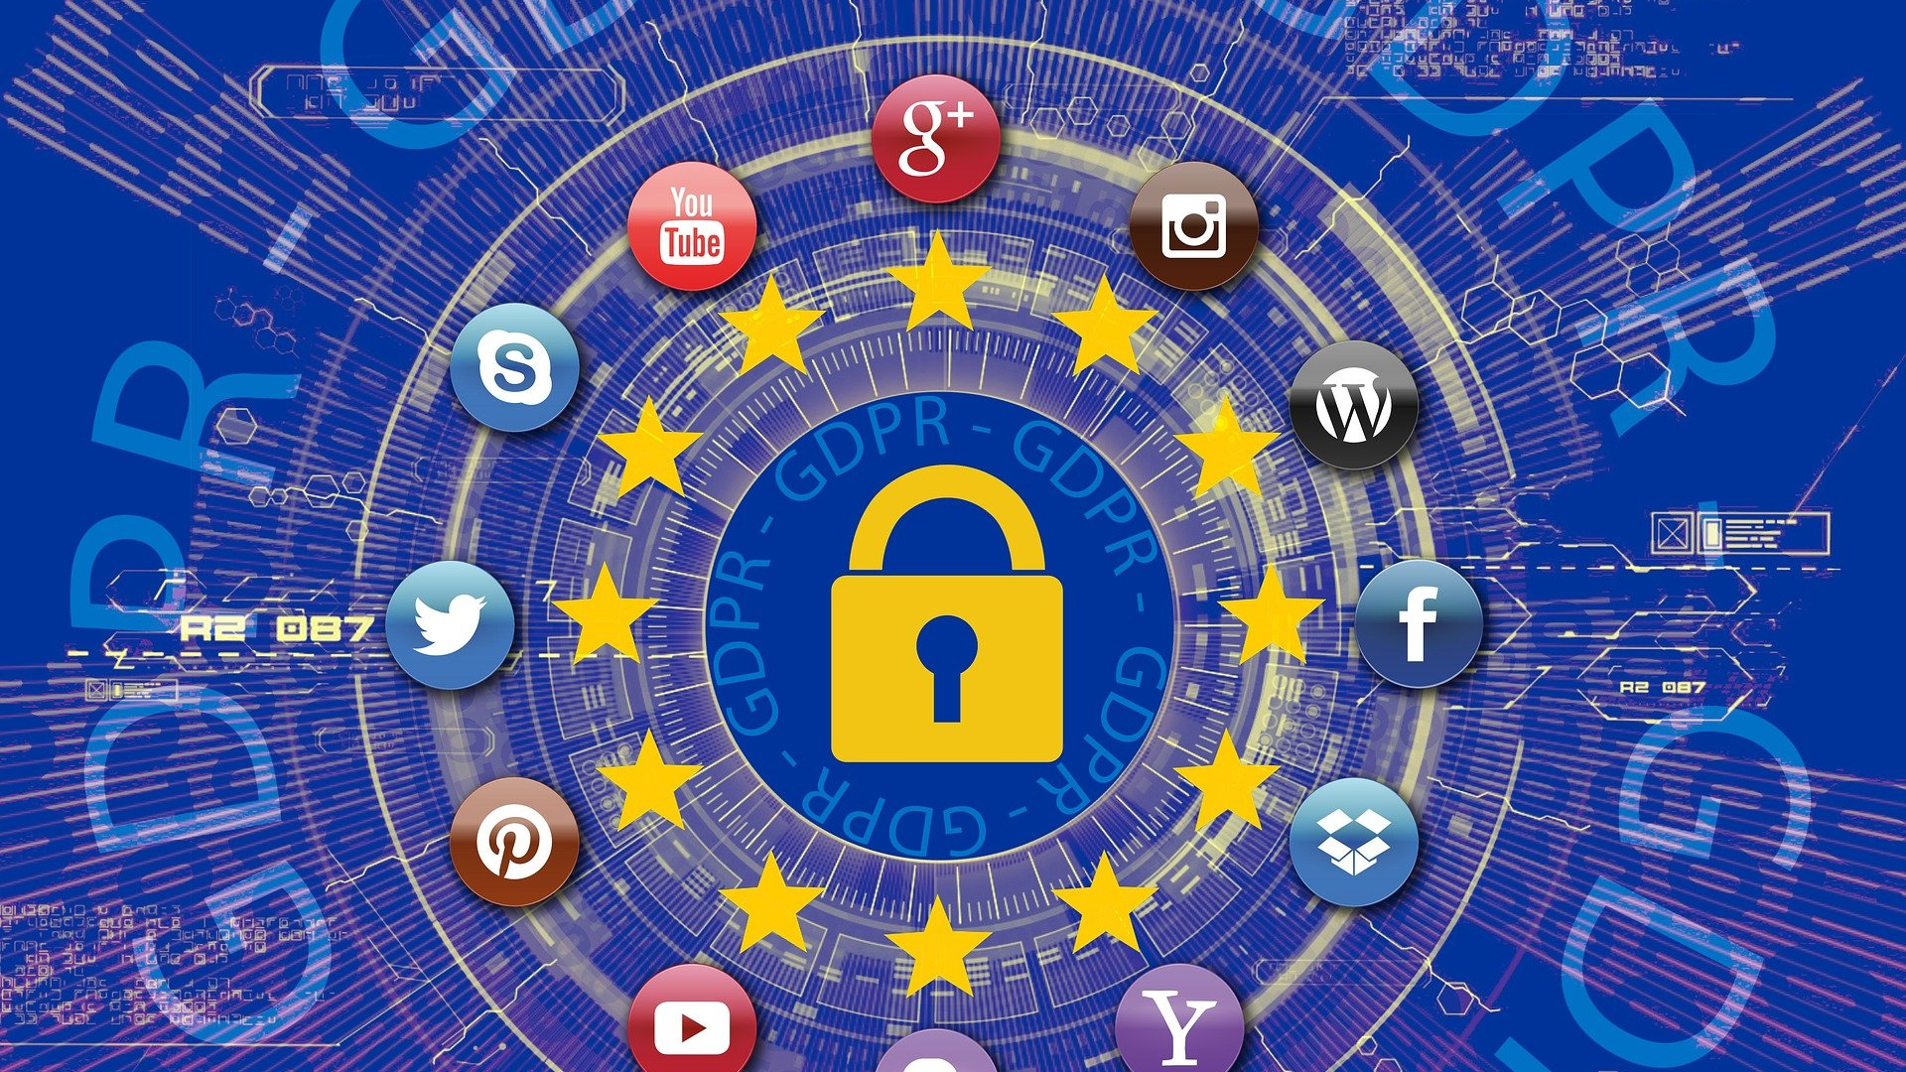
This Photo by Unknown Author is licensed under CC BY-SA
Notes:
In the wake of privacy concerns, the EU had introduced The General Data Protection Regulation (GDPR) law that aims to strengthen and clarify the rights of individuals with regard to their personal data and give them control over it \citep{europeancommission2016gdpr}. It imposes stricter rules on those hosting and processing personal data, as well as regulates the export of personal data outside the EU and European Economic Area (EEA).

Slide 8
Personalization
"the ability to proactively tailor products and purchase experience to the tastes of individual consumers based upon their personal and preference information" (Chellappa & Sin 2005, p. 181)
Positive effect: personalization can increase marketing return
Brand responses (Bauer, 2014)
Campaign responses (Kim & Sundar, 2012)
Brand engagement (Chu, 2011)
Ad persuasiveness (Tam & Ho, 205)
Email persuasiveness (Maslowska et al., 2011)
Notes:
Turning our attention to personalization, it’s “the ability to tailor products and purchase experience to individual consumers based on their personal and preference information”. Personalization depends on both the ability of vendors to acquire and process consumer information and the willingness of consumers to share information and use personalized services. Studies have shown that personalization can enhance marketing performance, improve brand engagement, increase switching costs and loyalty, and improve product or service fit and proactive delivery. Personalization is an important strategy for app developers to improve the engagement and success of their apps.
It can have a positive impact on mobile app outcomes by increasing search and download rates, driving higher revenue, and leading to more positive ratings and reviews.

Slide 9
Privacy-Personalization Tradeoff
Social Exchange Theory: Perceived benefits > Perceived Cost -> Disclose Personal Info.
Social Contract Theory: Marketers provide additional value (via personalization) -> Disclose Personal Info
U-shaped impact of personalization on ad performance
Positive: Personalization -> Central info processing -> Positive ad response
Negative: Personalization -> Persuasion knowledge -> Negative ad response
Notes:
There are mixed results of the interaction effects of personalization and privacy on consumer outcomes \cite[p. 147]{martin2016}. Some studies suggest that there is a tradeoff between personalization and privacy, while others suggest that there is no tradeoff.
Personalization can be perceived as a violation of privacy when it is not done with the consent or knowledge of the consumer. This tradeoff is supported by the findings of previous studies, which found that the use of personalization was negatively related to privacy concerns in the context of online advertising. Theories such as the Social Exchange Theory and the Social Contract Theory can explain this apparent tradeoff, as consumers may be willing to give up their privacy in exchange for the perceived benefits of personalization, but stricter privacy regulations may limit the ability of companies to use consumer data for personalization purposes.

Slide 10
Privacy-Personalization No Tradeoff
Personalization -> decrease privacy concerns
Highest personalization yields the most positive ad response, and privacy concerns do not mitigate this impact (Walrave et al., 2018)
Notes:
Studies have found that consumers tend to value personalization and privacy similarly, and that personalization can actually decrease privacy concerns by reducing unwanted marketing communication and increasing the relevance of ads.
In an experiment with three levels of personalization, low, medium, and high, Walrave found that …
Overall, the literature is mixed on the relationship between personalization and privacy, and more research is needed to fully understand the tradeoffs and interactions between these two factors in the context of consumer data.

Slide 11
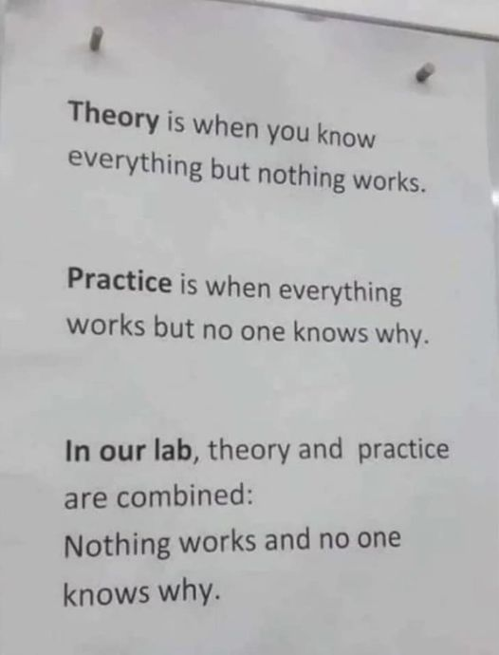
Theory and Practice

Slide 12


So what is it?
It depends.
Type of privacy actions:
Voluntary vs. Involuntary
Tradeoff or no tradeoff

Slide 13
Consumer Expectation
Personalization
Tradeoff
(Conventional wisdom)
Synergy
(what we observe)
What customers want
High
Undesirable Zone
Tradeoff
(Conventional wisdom)
Low
Low
High
Privacy Concerns

Slide 14
Hypotheses

Slide 15
Hypothesis 1
Search
Download
Revenue
Rating
Review
GDPR
(Involuntary)
Privacy Concerns
-
+
+
Privacy Protection
+
Notes:
The impact of GDPR on app outcomes is mixed, with some studies finding that it has led to a reduction in app usage and introductions, while others have found it has increased competition in the free app market but decreased competition in the paid app market.
GDPR affects app outcomes through its effects on privacy concerns and privacy protection. It addresses individuals' privacy concerns by imposing stricter rules on those hosting and processing personal data, which may lead to a reduction in app usage, but also aims to protect individuals' personal data and give them control over it, which may lead to an increase in app usage if users feel more confident about the handling of their personal data. The hypothesis of the study is that GDPR can have a mixed impact (either positive and negative) on app outcomes due to its effects on privacy concerns and privacy protection.

Slide 16
Hypothesis 1
Search
Download
Revenue
Rating
Review
GDPR
(Involuntary)
H1: +/-

Slide 17
Hypothesis 2
Search
Download
Revenue
Rating
Review
Privacy Concerns
-
+
Security Changes
(Voluntary)
Privacy Protection
+
+
Notes:
On the other hand, app developers' efforts to enhance the security of their apps have been shown to have a positive impact on app outcomes.
Security changes affect app outcomes through the mechanisms of privacy concerns and privacy protection. By addressing users' privacy concerns and enhancing the security of apps, app developers may increase user confidence in the handling of their personal data, leading to an increase in app usage. Security features may also trigger privacy concerns for consumers.
However, because security changes are voluntary actions by the app developers, the privacy concerns route is not prominent as compared to the case of involuntary actions such as GDPR.
Hence, we argue that for voluntary actions such as security changes, the privacy concerns route is not activated, while the privacy protection mechanisms can be highlighted with these actions.
Remember to mention that privacy concerns is not as pronounced in the case of voluntary actions versus the involuntary actions by government. That’s why we think we have more positive effect of privacy protection
For example, biometric authentication methods, such as facial recognition or fingerprint scanning, may raise privacy concerns as they involve the collection and processing of sensitive personal information \citep{ioannou2020privacy}.

Slide 18
Hypothesis 2
Search
Download
Revenue
Rating
Review
Security Changes
(Voluntary)
H2: +

Slide 19
Conceptual Model
Search
Download
Revenue
Rating
Review
GDPR
(Involuntary)
Privacy Concerns
H1: +/-
-
+
+
Security Changes
(Voluntary)
Privacy Protection
+
H2: +
+
Notes:
To highlight the contrast between voluntary vs. involuntary action.
However, the effectiveness of these actions may depend on whether they are implemented voluntarily or involuntarily by the company and how they are perceived by consumers.

Slide 20
Hypothesis 3
Search
Download
Revenue
Rating
Review
GDPR
(Involuntary)
H1: +/-
Personalization
H3: +
Security Changes
(Voluntary)
H2: +
Notes:
The combination of personalization and security changes can have a positive impact on app outcomes
Personalization can increase consumer satisfaction and engagement, leading to higher revenue and more downloads, while strong security measures can protect sensitive personal data and build consumer trust, resulting in higher ratings and more positive reviews.

Slide 21
Hypothesis 4
Search
Download
Revenue
Rating
Review
GDPR
(Involuntary)
H1: +/-
H4: -
Personalization
H3: +
Security Changes
(Voluntary)
H2: +
Notes:
However, Personalization and GDPR can have a tradeoff relationship when it comes to shaping app outcomes. GDPR can have either a direct positive or negative effect on app outcomes depending on how it is implemented and perceived by consumers.
The implementation of GDPR requirements can be perceived as burdensome or unnecessary by consumers, which may have a negative impact on trust and perceived value. In this context, personalization can be seen as a way to balance the potentially negative effects of GDPR on app outcomes by allowing app developers to use personal data in a targeted and relevant way while complying with GDPR requirements.
H4: Personalization can have a dampening effect on the impact of GDPR on app outcomes

Slide 22
Hypothesis 5
Search
Download
Revenue
Rating
Review
GDPR
(Involuntary)
H1: +/-
H5: -
Security Changes
(Voluntary)
H2: +
Notes:
For our last hypothesis, The idea of a substitution effect between GDPR and security changes suggests that the implementation of GDPR may lead to a decrease in the importance of security measures in protecting consumer privacy. This is because GDPR is a government regulation that aims to strengthen and clarify individuals' rights to their personal data. As a result, consumers may perceive GDPR as being more effective in addressing their privacy concerns, leading them to place less emphasis on the importance of security measures. Research by \cite{milberg2000} supports this idea, showing that when firms lack privacy regulations, consumers tend to demand more government intervention. This may lead to the substitution of security measures with GDPR as a more effective means of protecting consumer privacy.

Slide 23
Hypothesis 5
Search
Download
Revenue
Rating
Review
GDPR
(Involuntary)
H1: +/-
H3: -
Personalization
H4: +
Security Changes
(Voluntary)
H2: +
Notes:
backup

Slide 24
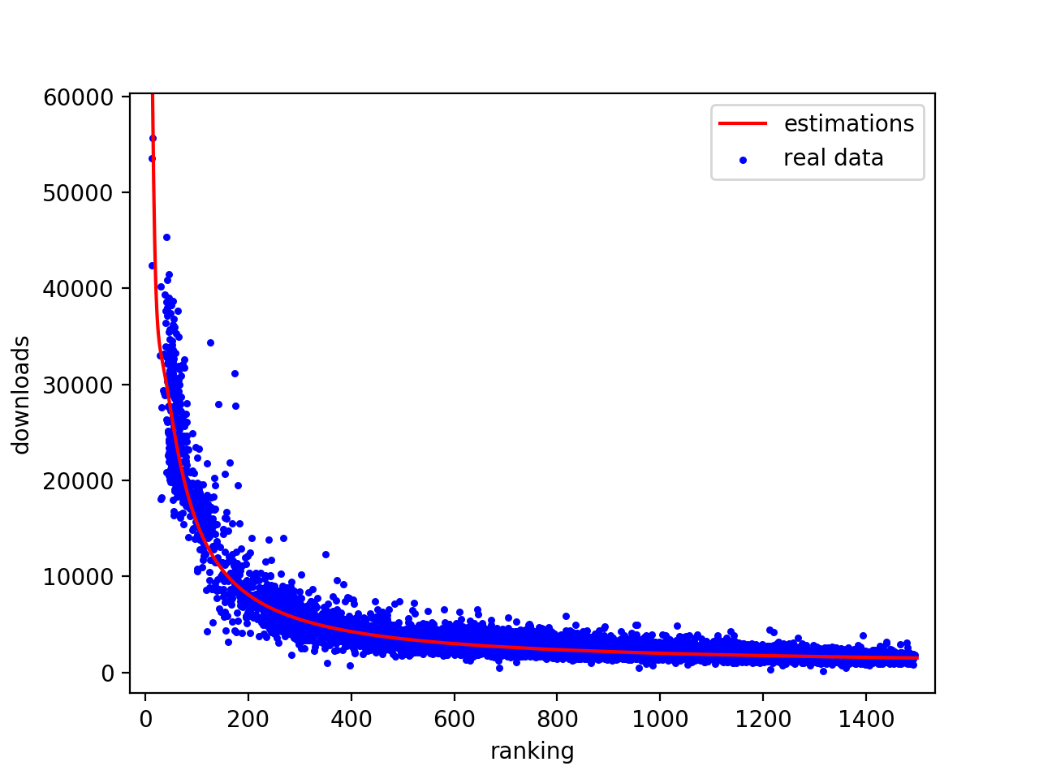
Data
Context: Healthcare apps
Data: 304 apps in 4 countries (US, IT, GE, FR)
238,643 observations
Outcomes:
Search
Downloads
Revenues
Rating
Review
Notes:
After proposing our hypotheses, we’d like to describe our data
The data used for this study is related to healthcare apps. The healthcare industry is used as a context to investigate the trade-off between privacy and personalization and how GDPR impacted the trade-off. The study collected data from the Apple App Store's Health & Fitness category in four countries, the United States, France, Germany, and Italy. The data focuses on apps that were available and active in all four countries, before and after the implementation of GDPR. The final data comprises of 304 applications with 238,643 weekly observations. The study measures users' engagement with the app through five variables, namely, search intensity, downloads, revenue, ratings, and review. The data was collected from various sources such as the Apple App Store, AppTweak, and others
Remember to define each outcome variable

Slide 25
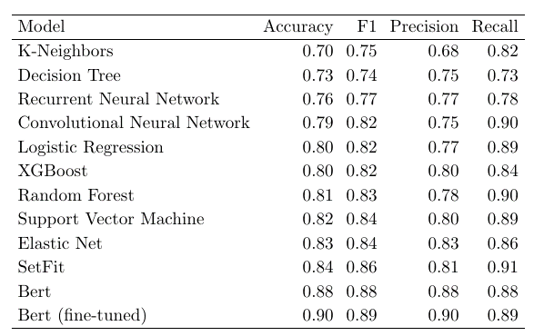
Personalization Measurement
Notes:
For each app in our dataset, we have the list of all updates since the app was released as well as the release note containing the details of new app features. There are a total of 33,801 release notes from year 2012 to 2020.
What is the definition of personalization? Make sure to mention why it’s different from customization.
Our definition of personalization included considerations such as the use of personalized in-app messages, location-based data, personalized recommendations, and integration with social networks. For example, we considered an app to be personalized if it used location data to personalize the user’s experience, offered specific services based on time or location, or presented users with content that is highly relevant through push notifications.
In order to determine whether a mobile app release note is related to personalization or not, we developed a machine learning model using a manually coded training dataset. We evaluated the performance of several algorithms, including k-nearest neighbors, decision tree, logistic regression, XGBoost, etc. After comparing the performance of all the algorithms, we found that BERT had the highest accuracy and F1 score and therefore selected it as our final model. Our prediction model performed well in the context of app updates, with results that compare favorably to those reported in previous studies (\citealt{karanam2022design})
For reference, the best paper in the same context only achieves 76% accuracy. And the recommended threshold in the marketing literature is 80% by Berger 2020

Slide 26
Security Measurement
Keywords
security, data, password, sign in, account, register, backup, login, sign-in, signing in
Coders: 3 RAs
Notes:
An update is considered as a security update if it indicates that the app is adding a feature that protects users' information. For example the option to create an account, adding backup options, integration with more secure platforms such as Apple or Google for account creation. We extract the updates that included keywords related to security\footnote{The keywords are security, data, password, sign in, account, register, backup, login, sign-in, signing in.} and use two human coders to identify the updates that include security increasing features. A third coder helped resolve any discrepancies (for 13\% of the sentences)

Slide 27
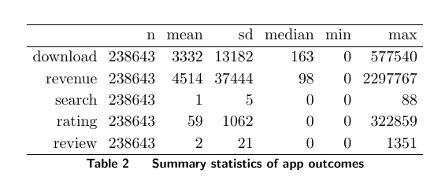
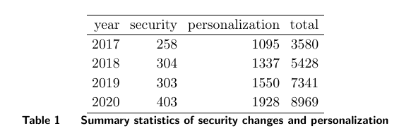
Descriptive Statistics
Notes:
a brief overview of the sample you are using, the time period and the countries under study.

Slide 28
Model Free Evidence

Slide 29
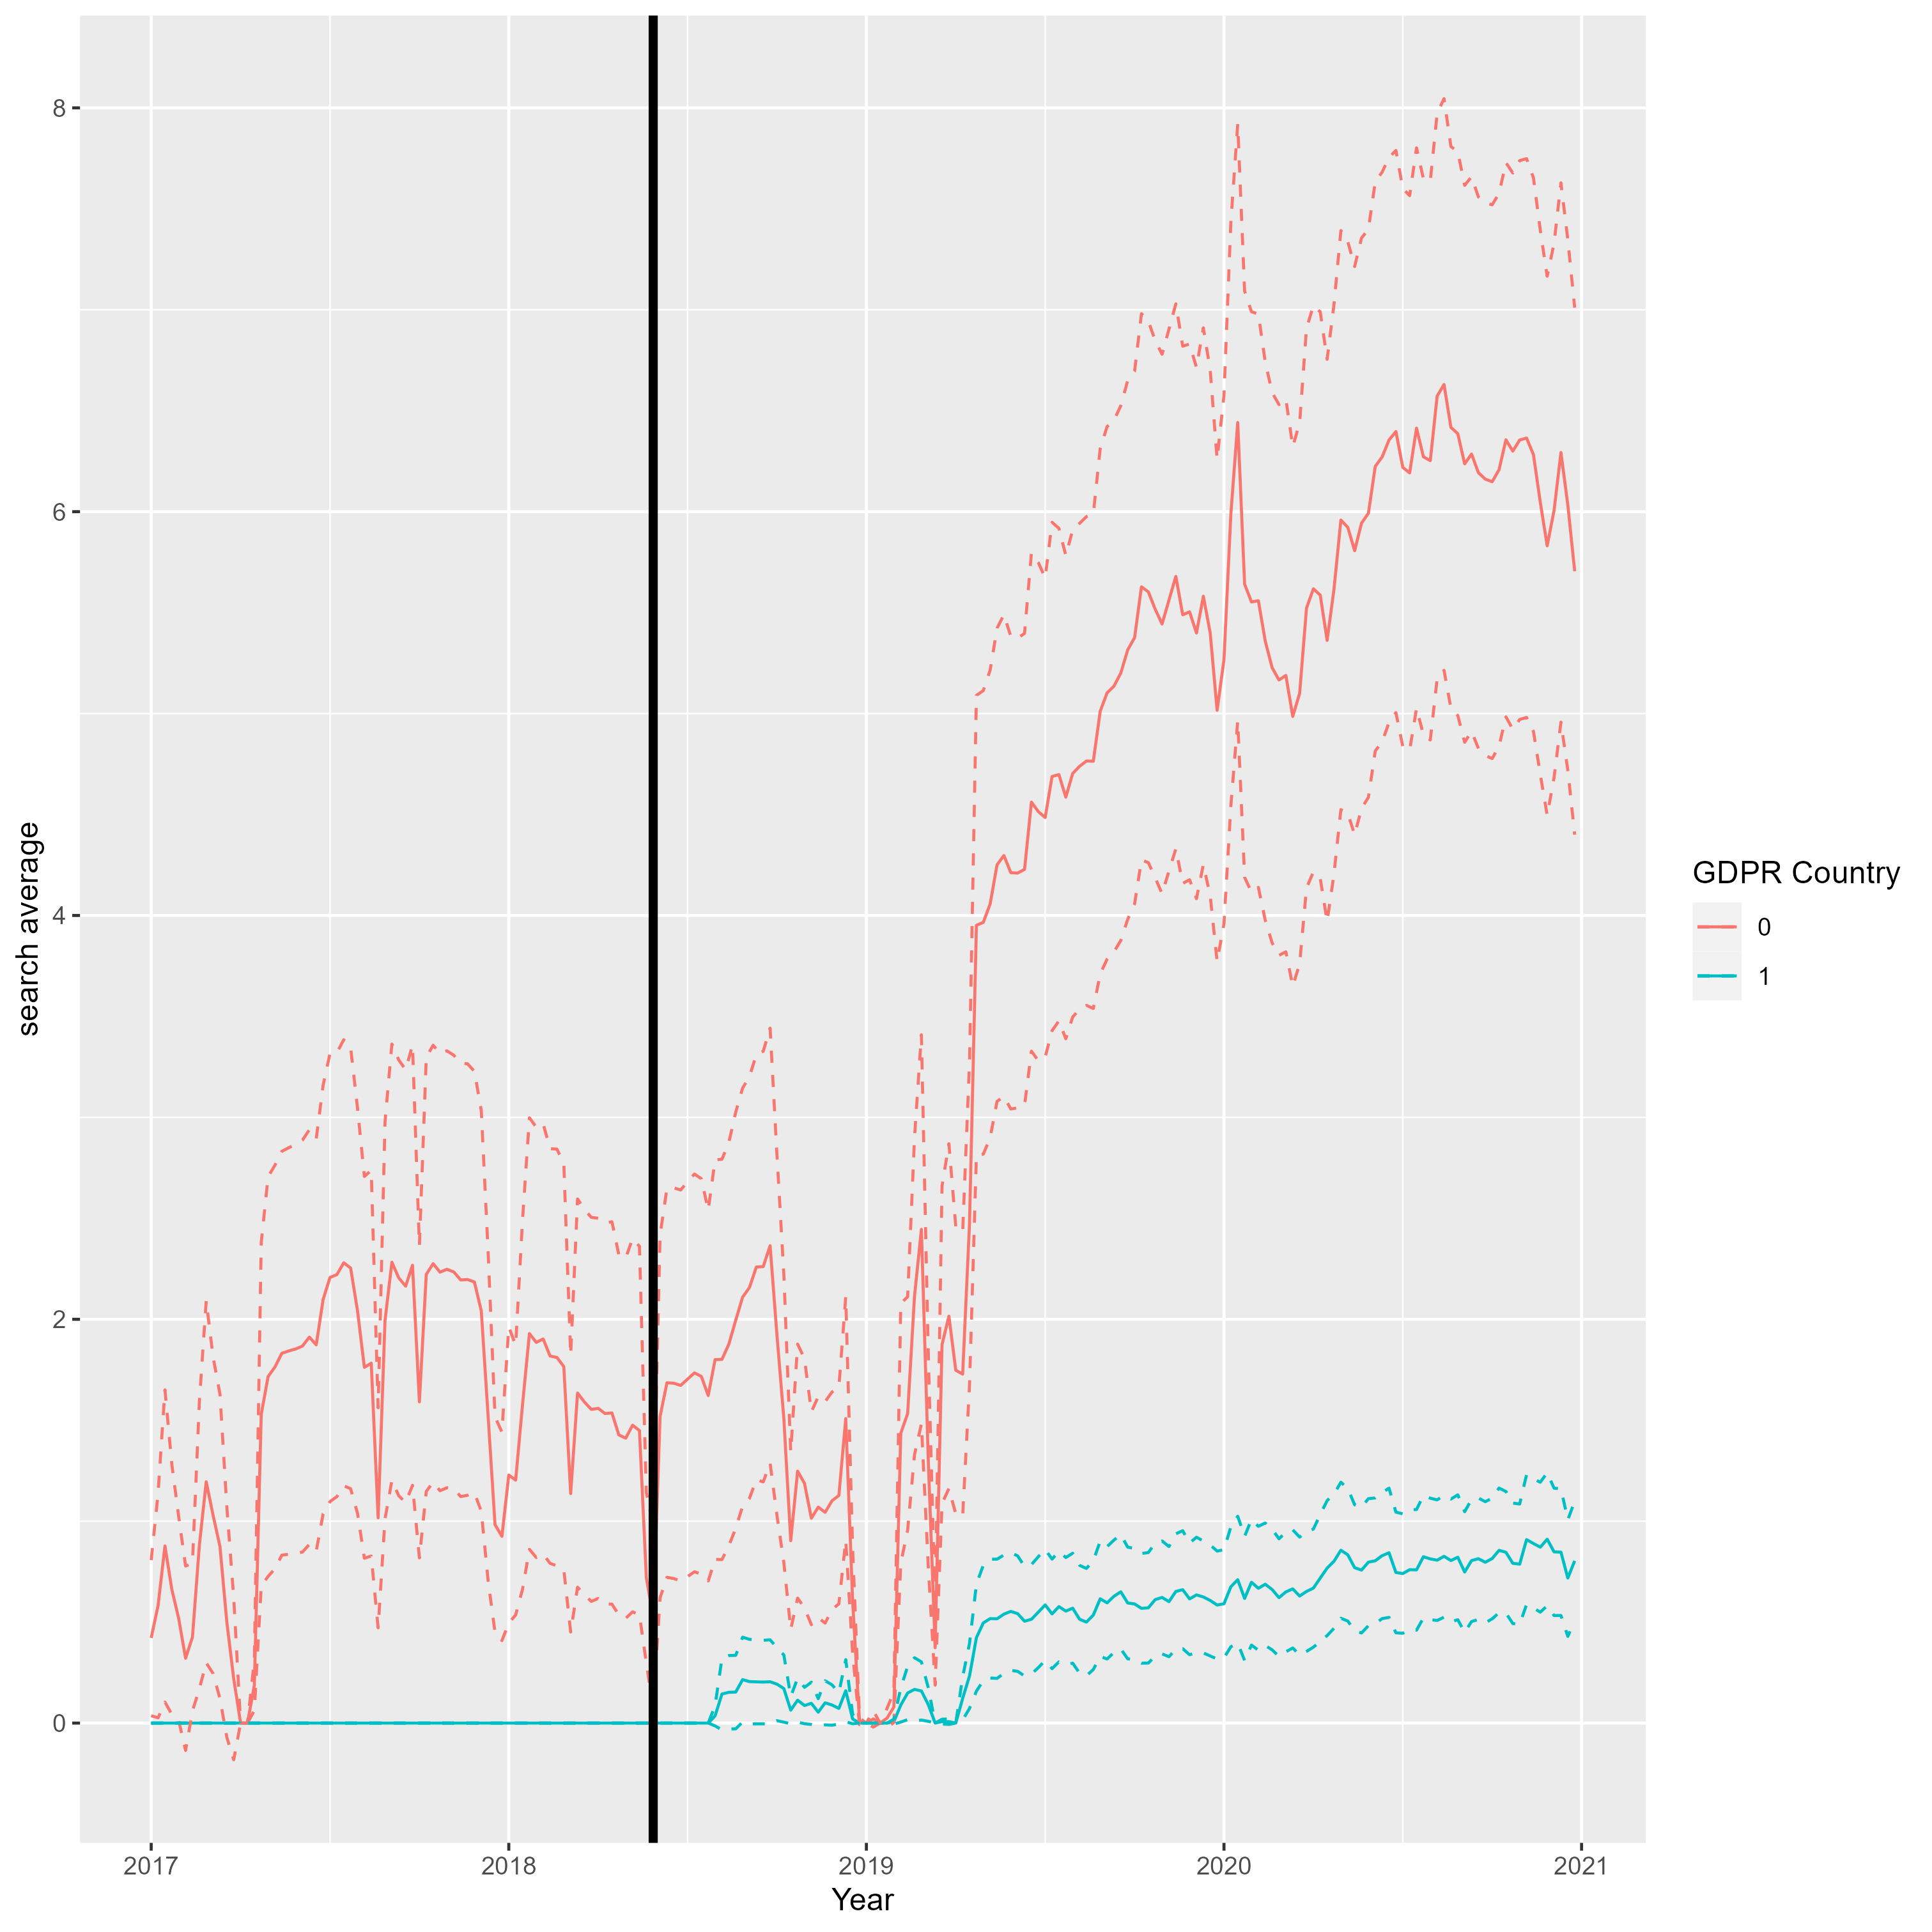
Search

Slide 30
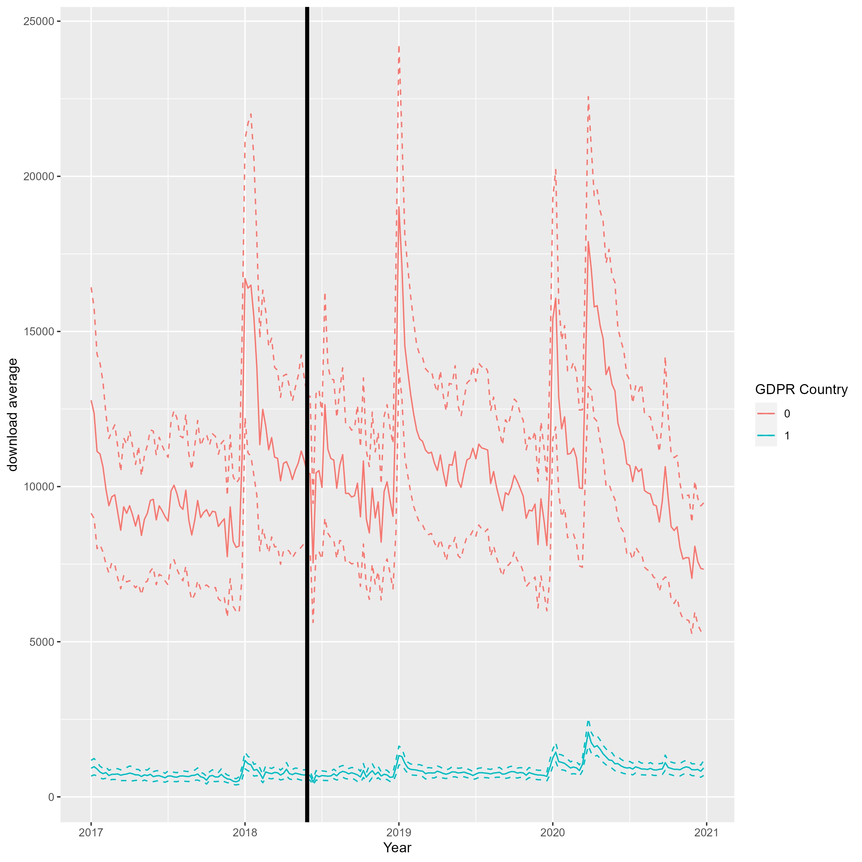
Download

Slide 31
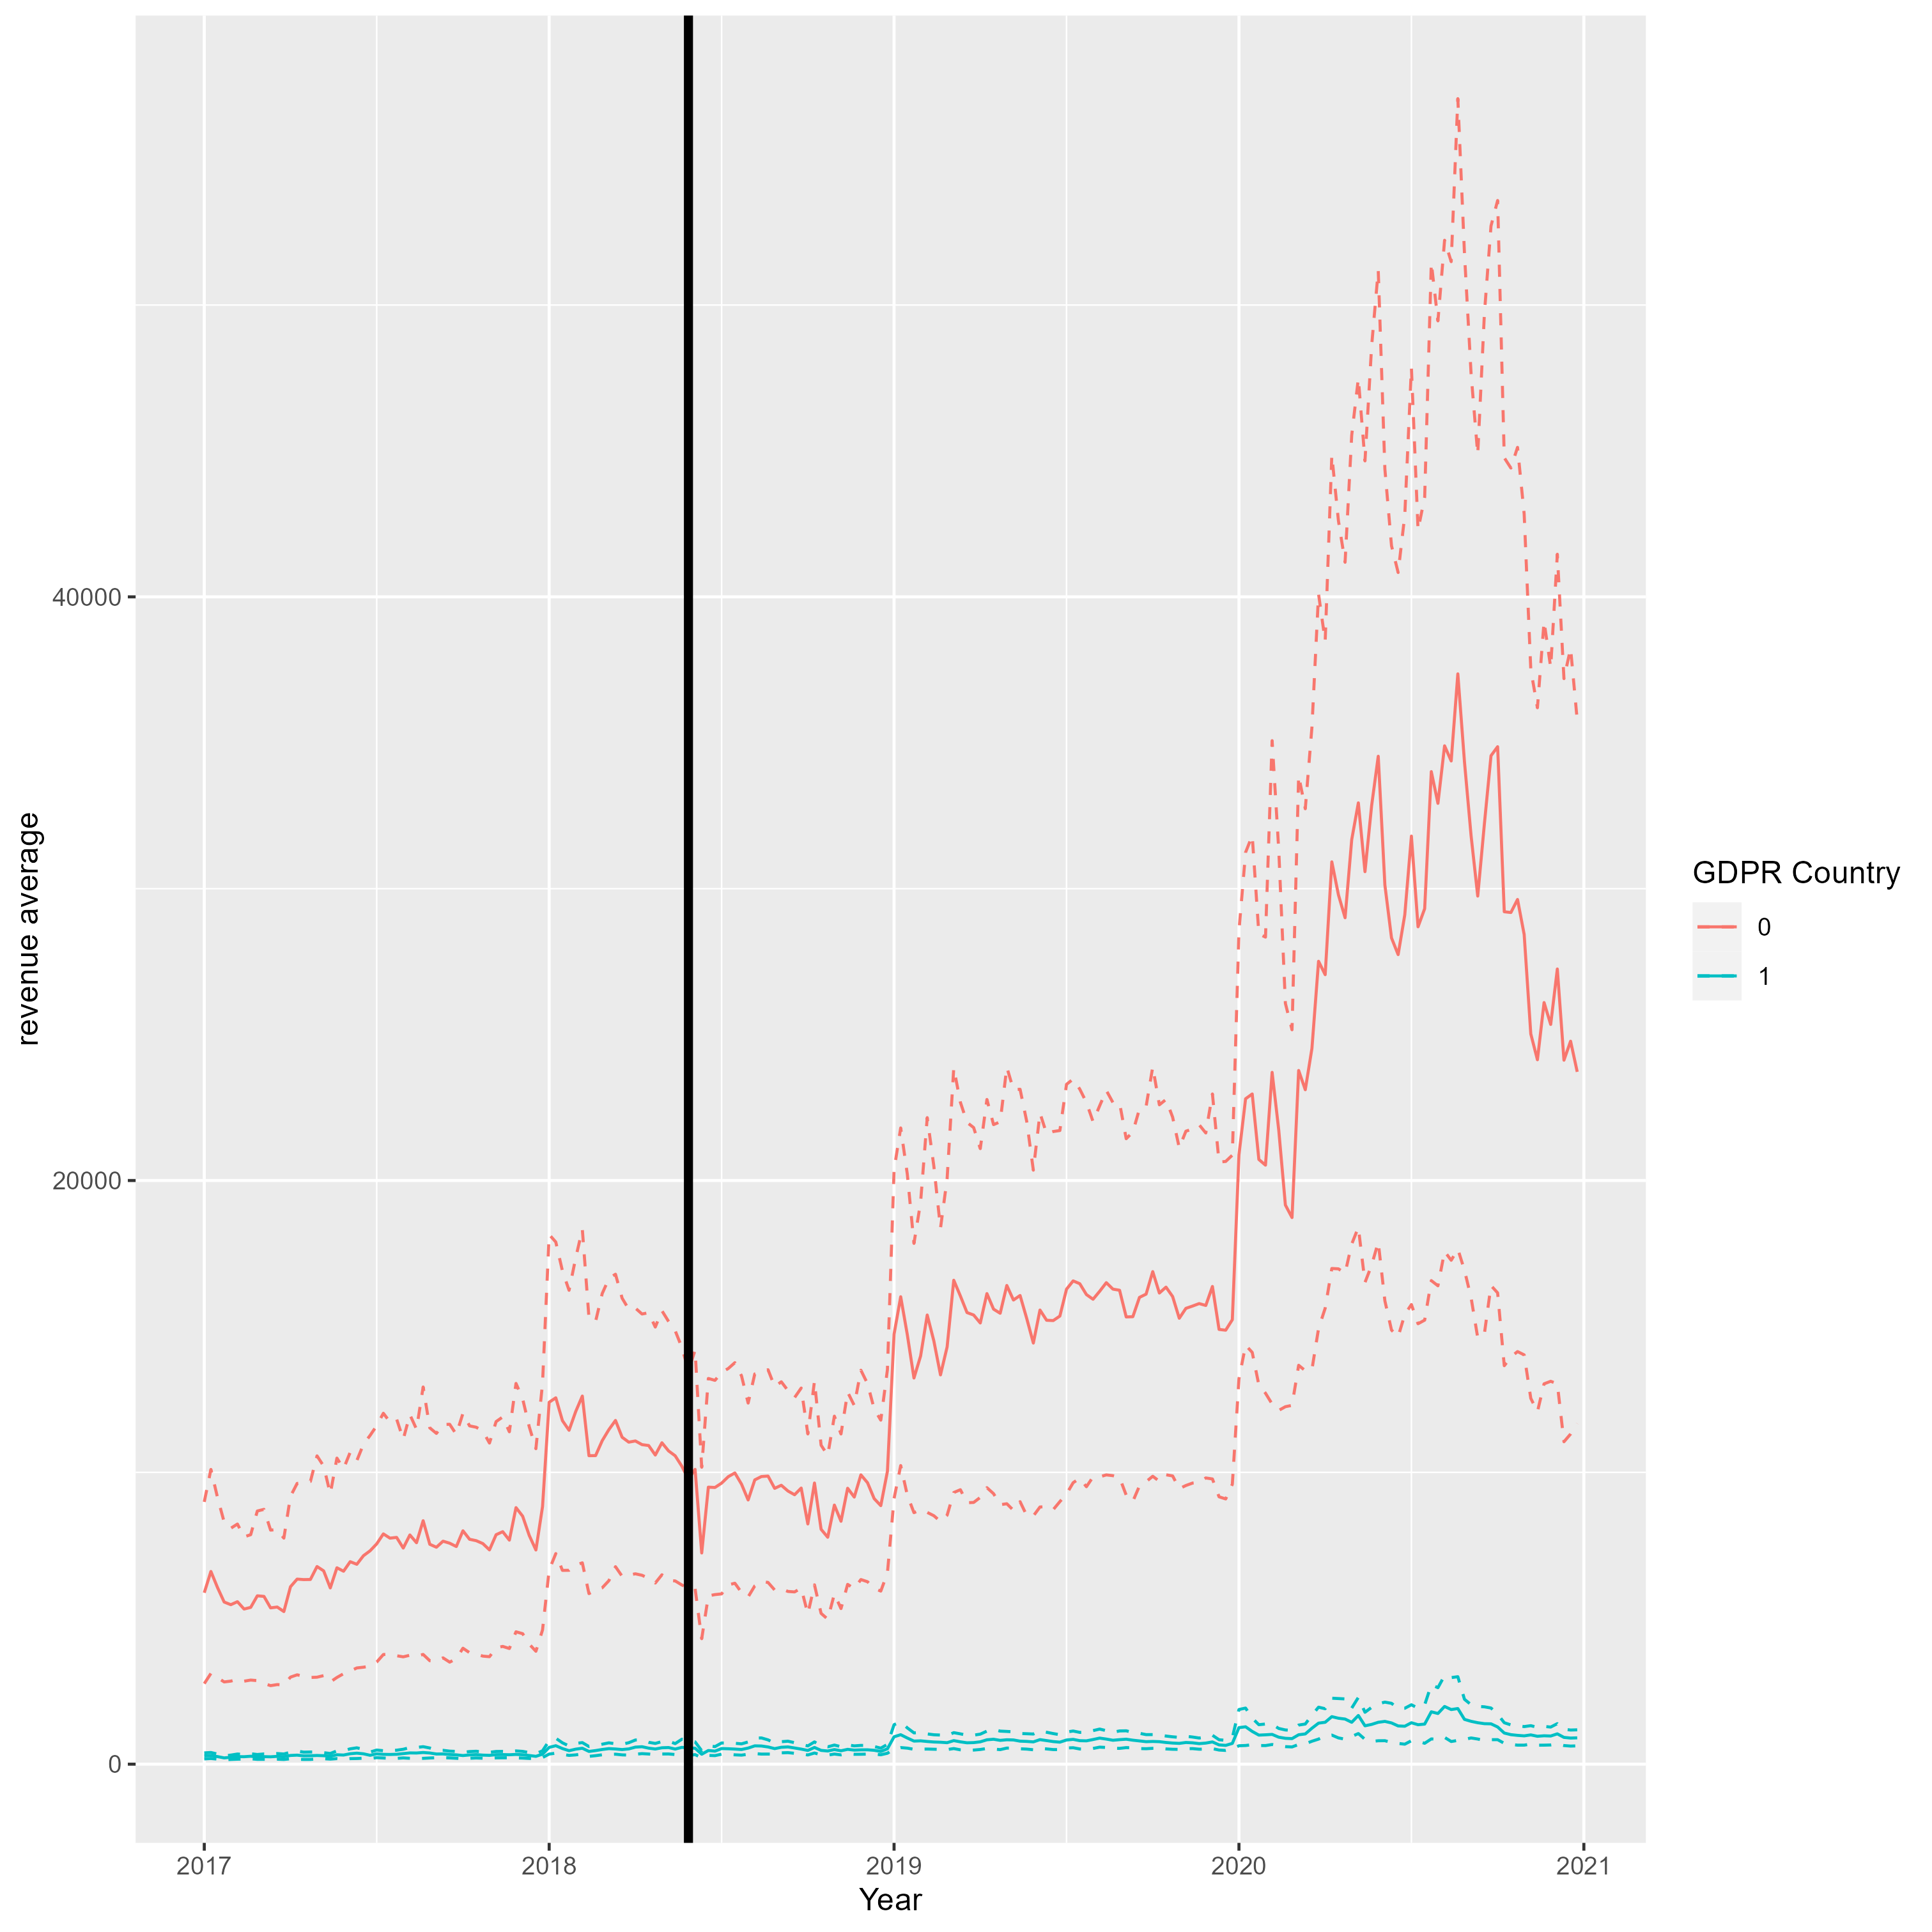
Revenue

Slide 32
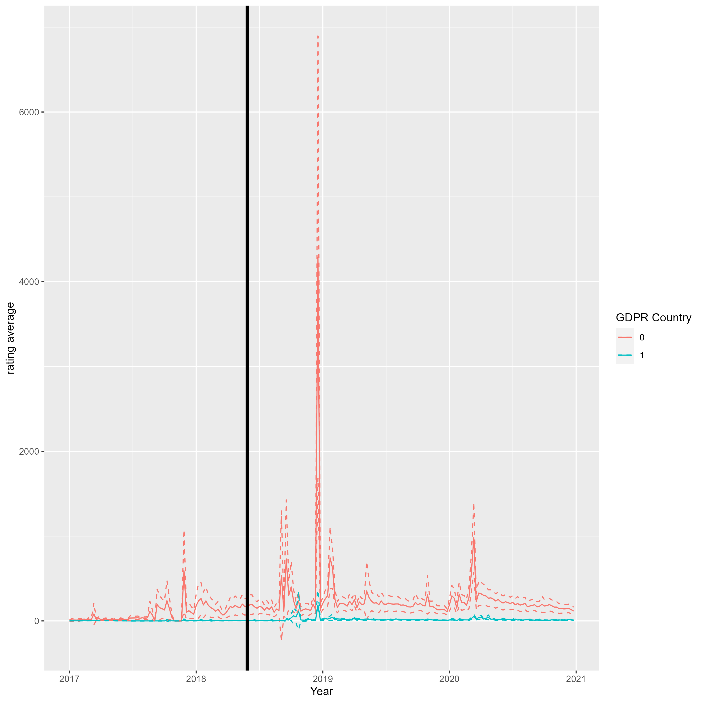
Rating

Slide 33
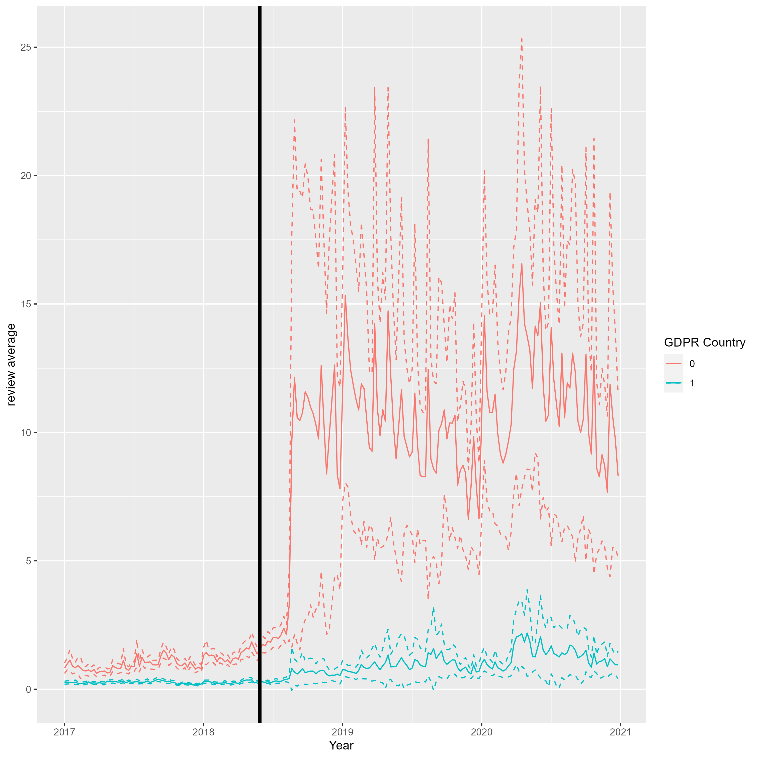
Review

Slide 34
Identification Strategy
DiD: Before and after GDPR
Control for
Variables affect apps outcomes
Fixed effects: Country, Time, App
Exclude apps that made any privacy policies (n = 63)
Notes:
The study uses a difference-in-differences (DiD) identification strategy, comparing changes in app outcomes in the EU after GDPR implementation with a baseline of changes in outcomes of the same group of apps in the U.S. over the same time period. The study also controls for any inherent differences in engaging with the apps across the users of the four countries by incorporating time fixed effects and controlling for changes in the market that may be due to shifts in users’ preferences, competition, new technology, or any other external changes. The study excludes all the apps (63 apps) that made changes to their privacy policies before or in year 2018, even if the updated was not directly related to GDPR.

Slide 35
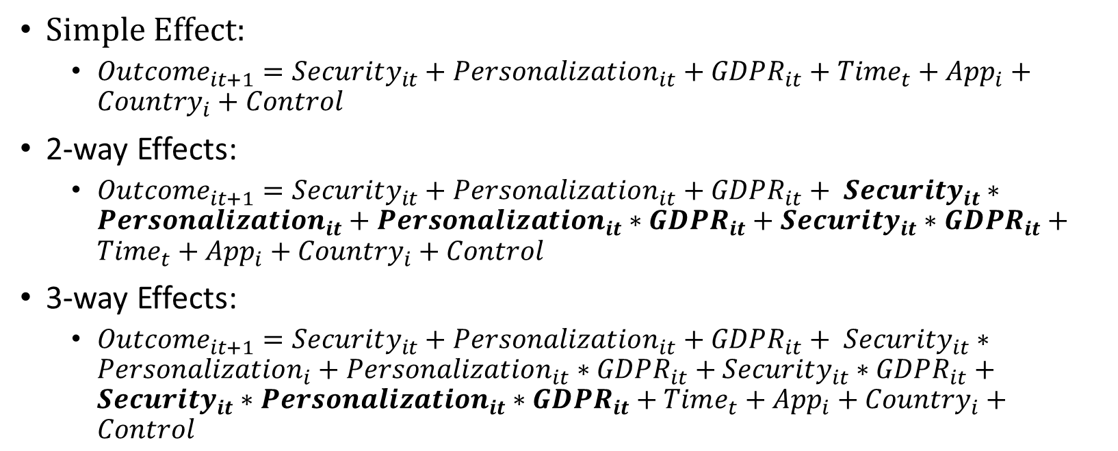
Regressions
$Simple Effect:$
$Outcome_{it+1}=Security_{it}+Personalization_{it}+GDPR_{it}+Time_{t}+App_{i}+Country_{i}+Control$
2-way Effects:
$Outcome_{it+1}=Security_{it}+Personalization_{it}+GDPR_{it}+ Security_{it}∗Personalization_{it}+Personalization_{it}∗GDPR_{it}+Security_{it}∗GDPR_{it}+Time_{t}+App_{i}+Country_{i}+Control$
3-way Effects:
$Outcome_{it+1}=Security_{it}+Personalization_{it}+GDPR_{it}+ Security_{it}∗Personalization_{i}+Personalization_{it}∗GDPR_{it}+Security_{it}∗GDPR_{it}+Security_{it}∗Personalization_{it}∗GDPR_{it}+Time_{t}+App_{i}+Country_{i}+Control$

Slide 36
Parallel Trends Evidence

Slide 37
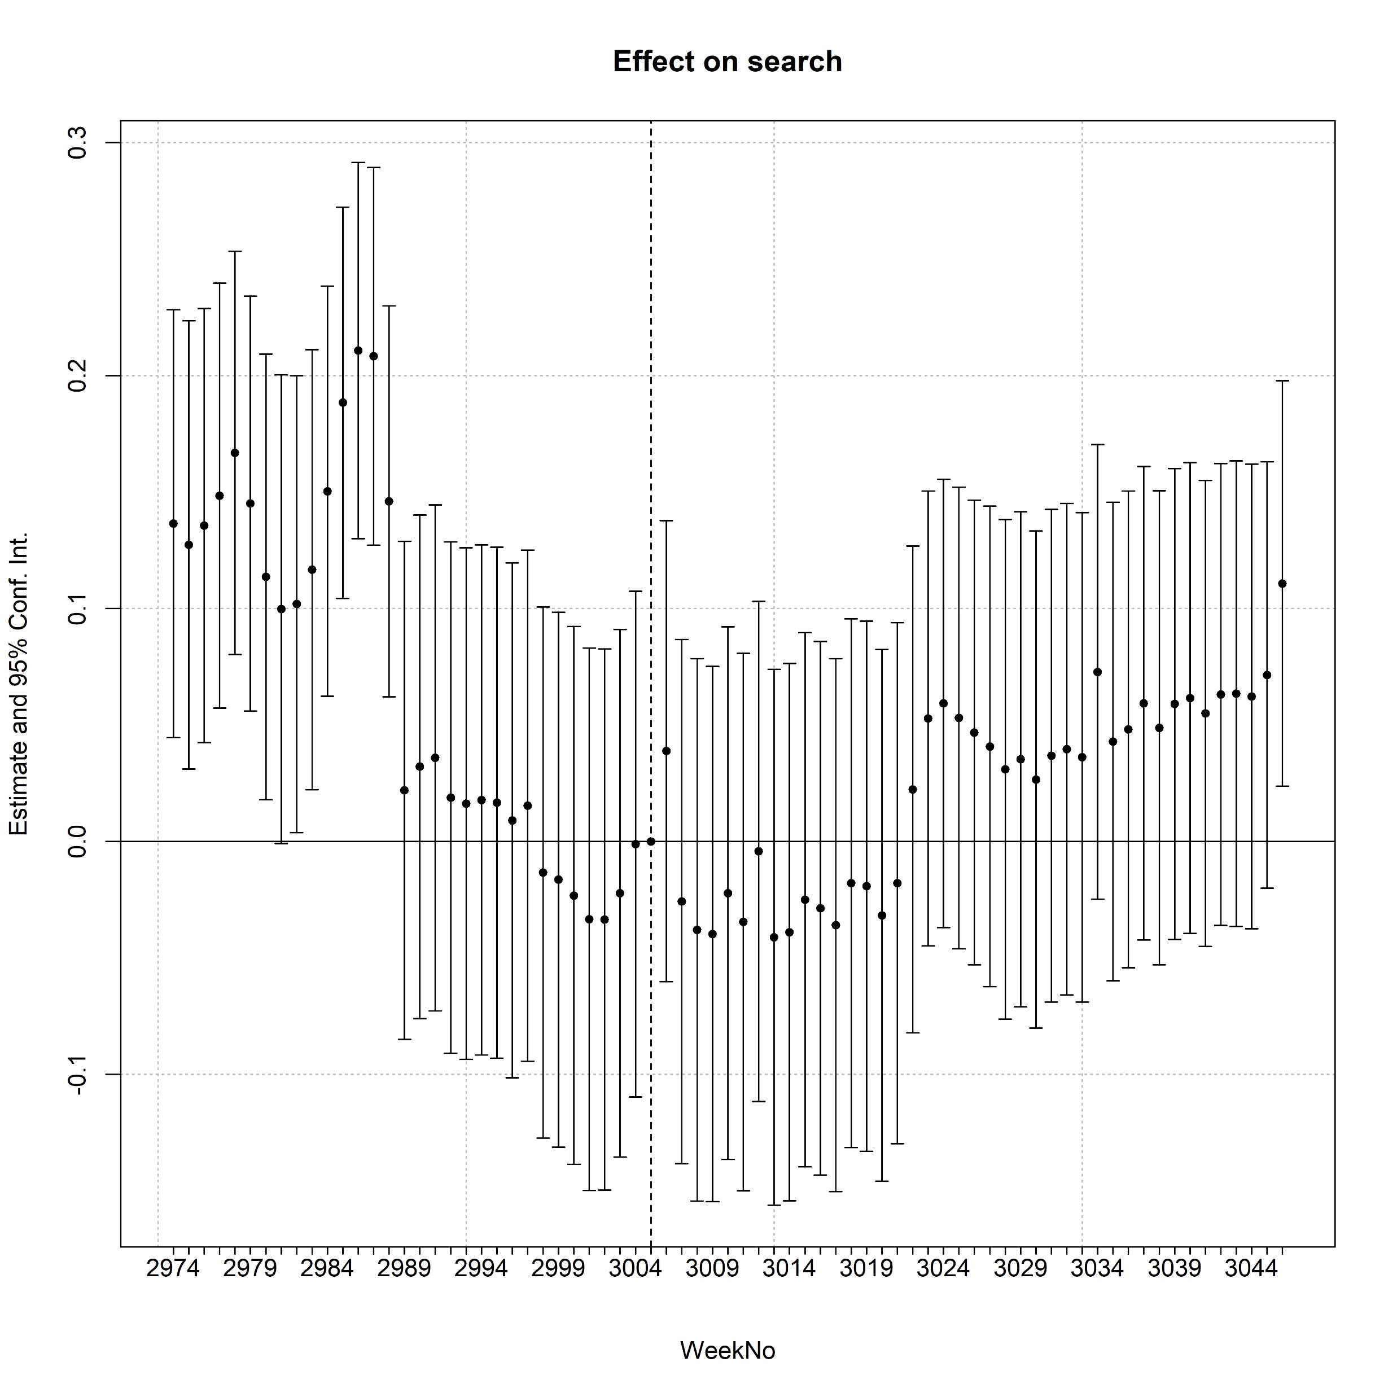
Search

Slide 38
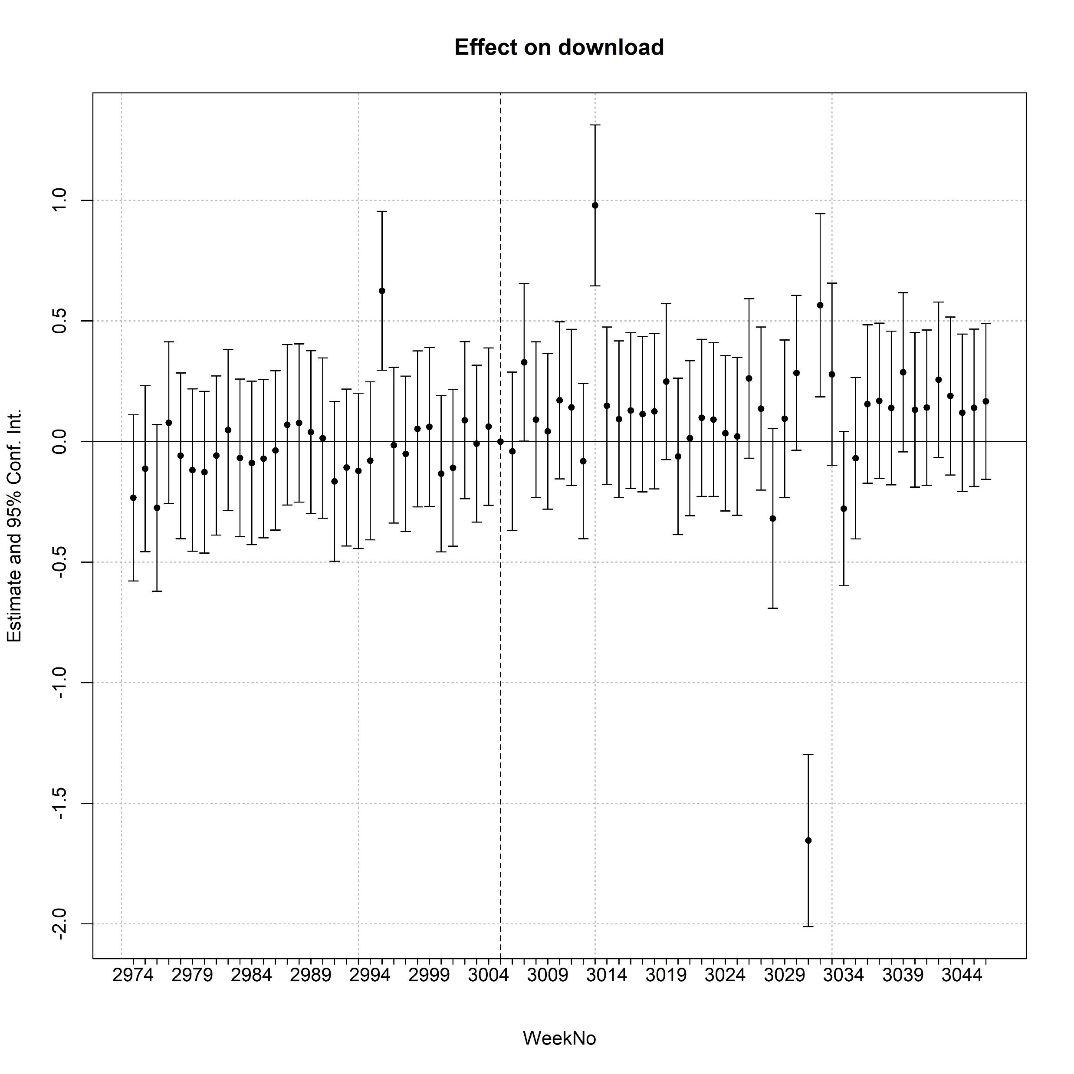
Download

Slide 39
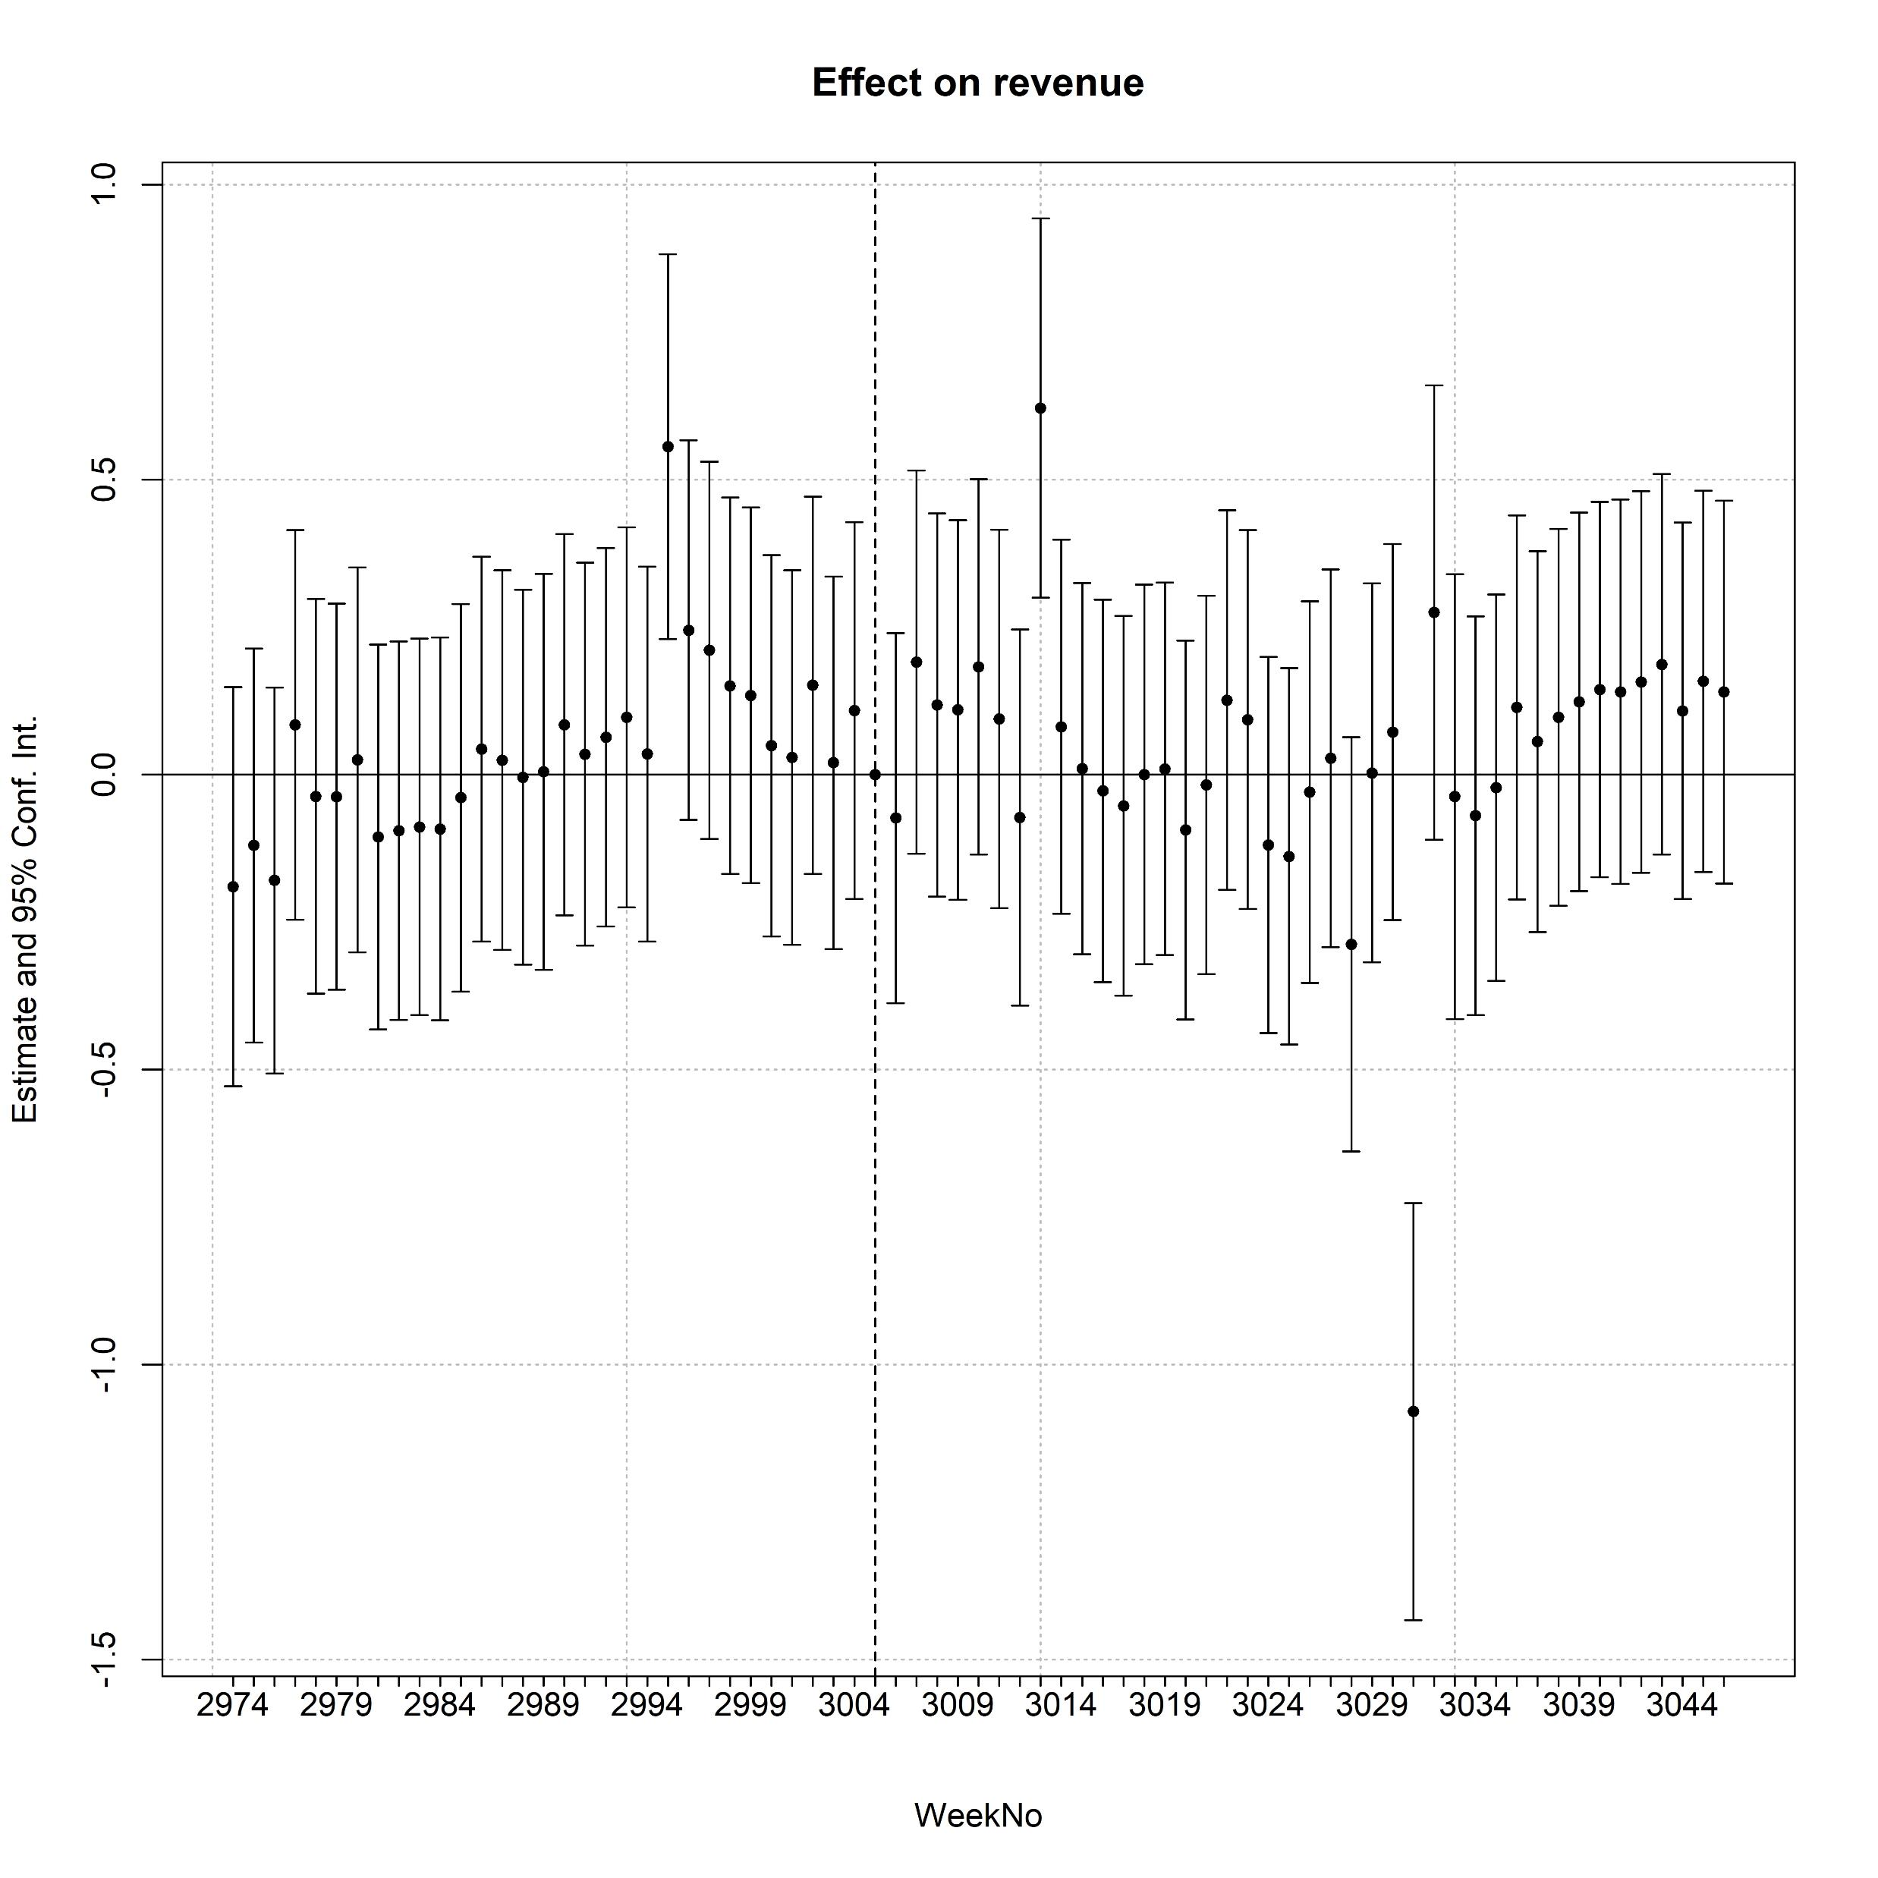
Revenue

Slide 40
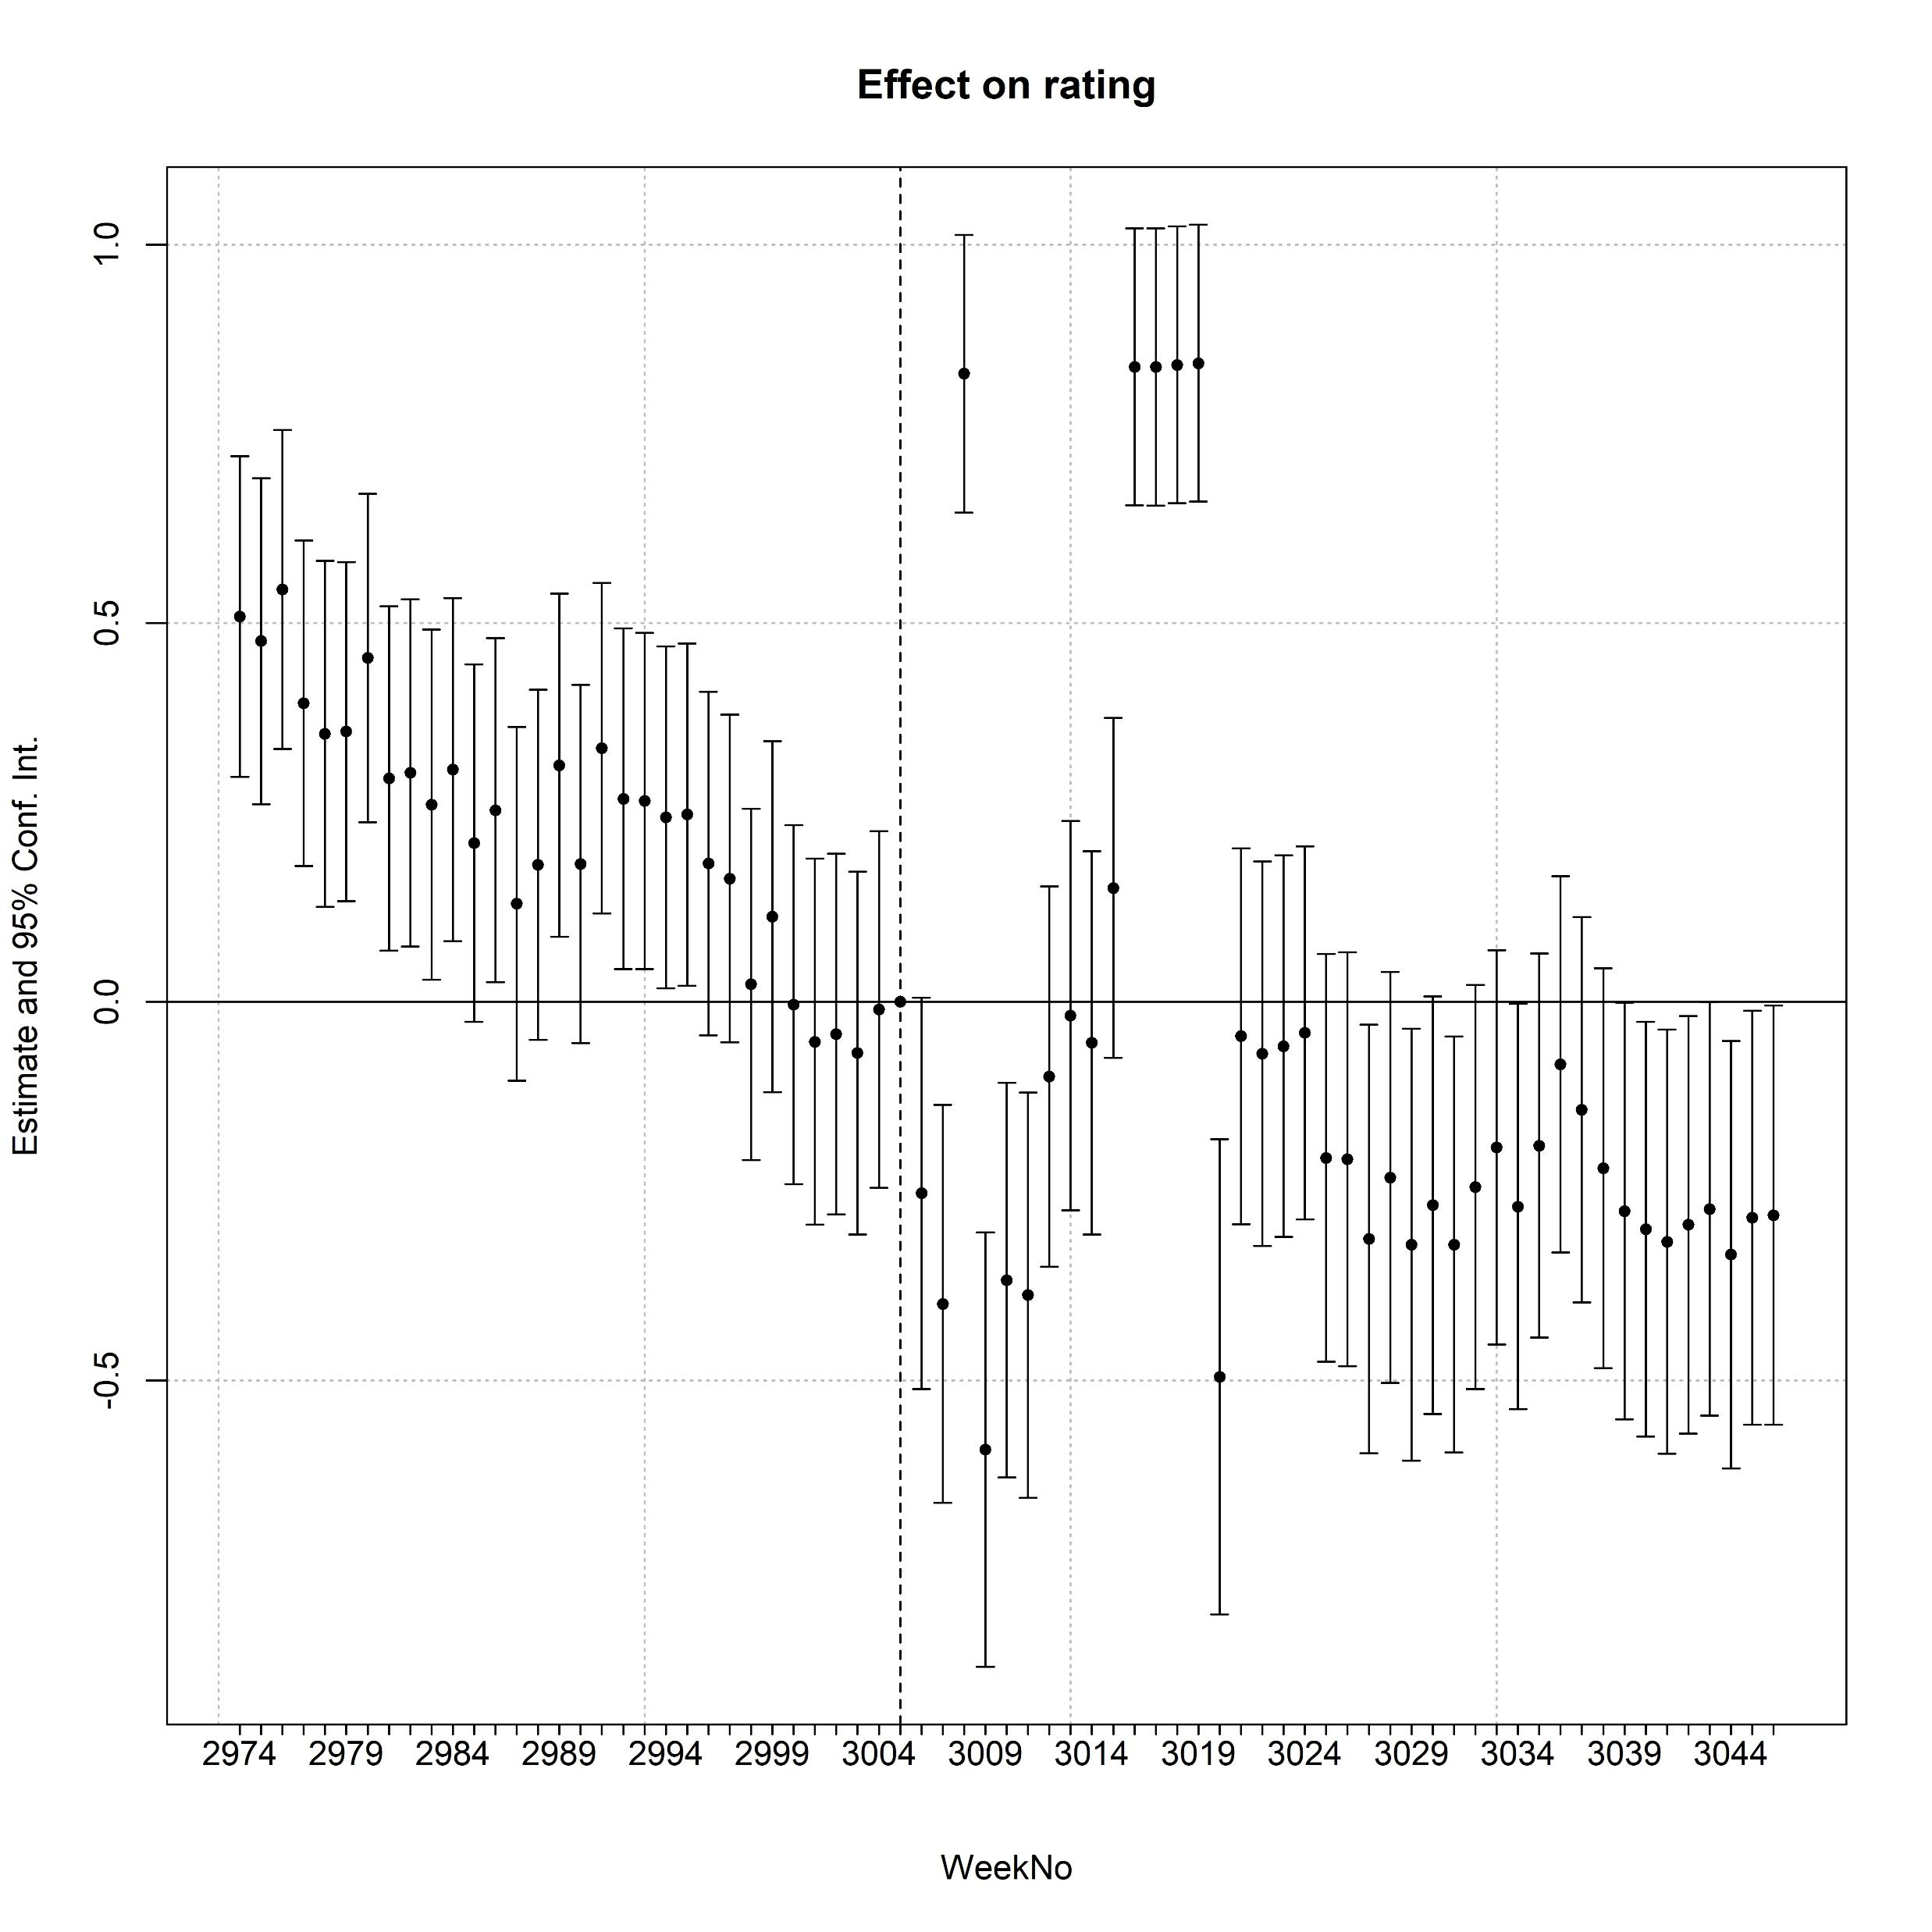
Rating

Slide 41
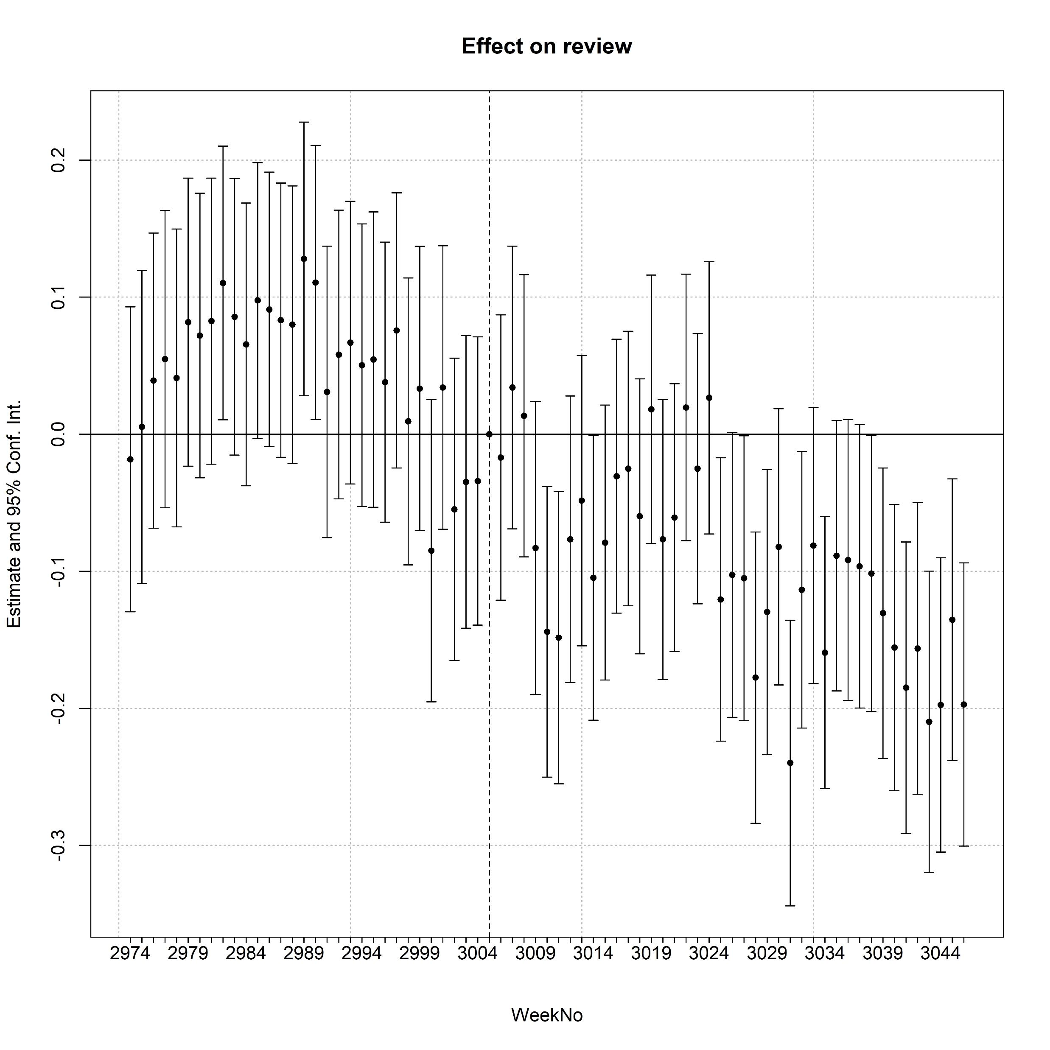
Review

Slide 42
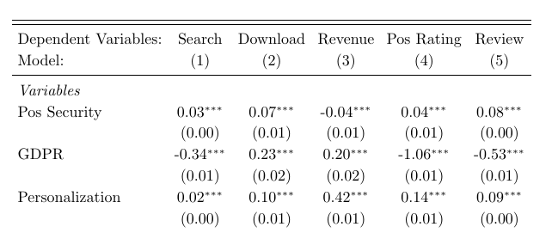
Main Effects

Slide 43
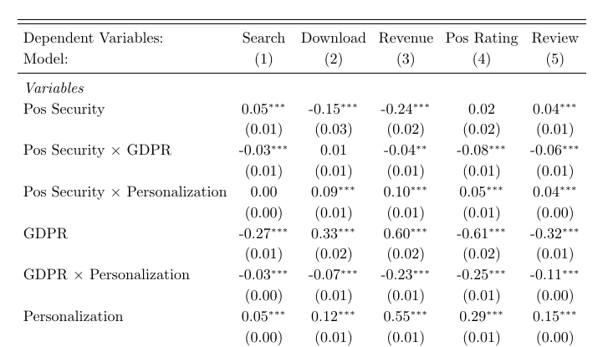
2-way Interaction
Notes:
There is a tradeoff between personalization and privacy in the form of involuntary actions
A synergistic effect between personalization and privacy in the form of voluntary actions
And lastly, there is a substation effect between the two types of actions.

Slide 44
Marginal Effects
term | contrast | search | download | revenue | rating | review
GDPR | 1 - 0 | -0.324***(0.006) | 0.247***(0.018) | 0.274***(0.019) | -0.973***(0.015) | -0.488***(0.007)
personalization | dY/dX | 0.03***(0.003) | 0.123***(0.009) | 0.477***(0.009) | 0.189***(0.007) | 0.113***(0.003)
security | dY/dX | 0.041***(0.005) | -0.036*(0.017) | -0.126***(0.015) | 0.045***(0.01) | 0.062***(0.005)

Slide 45
Summary
Hypothesis | Effects | Expectation | Pre-purchase |  | Purchase | Post-purchase
 |  |  | Search | Download | Revenue | Rating | Review
1 | Involuntary Actions Main Effects | +/- | - | + | + | - | -

Slide 46
Summary
Hypothesis | Effects | Expectation | Pre-purchase |  | Purchase | Post-purchase
 |  |  | Search | Download | Revenue | Rating | Review
1 | Involuntary Actions Main Effects | +/- | - | + | + | - | -
2 | Voluntary Actions Main Effects | + | + | + | - | + | +

Slide 47
Summary
Hypothesis | Effects | Expectation | Pre-purchase |  | Purchase | Post-purchase
 |  |  | Search | Download | Revenue | Rating | Review
1 | Involuntary Actions Main Effects | +/- | - | + | + | - | -
2 | Voluntary Actions Main Effects | + | + | + | - | + | +
3 | Personalization Enhancing Effects | + |  | + | + | + | +

Slide 48
Summary
Hypothesis | Effects | Expectation | Pre-purchase |  | Purchase | Post-purchase
 |  |  | Search | Download | Revenue | Rating | Review
1 | Involuntary Actions Main Effects | +/- | - | + | + | - | -
2 | Voluntary Actions Main Effects | + | + | + | - | + | +
3 | Personalization Enhancing Effects | + |  | + | + | + | +
4 | Personalization Dampening Effects | - | - | - | - | - | -

Slide 49
Summary
Hypothesis | Effects | Expectation | Pre-purchase |  | Purchase | Post-purchase
 |  |  | Search | Download | Revenue | Rating | Review
1 | Involuntary Actions Main Effects | +/- | - | + | + | - | -
2 | Voluntary Actions Main Effects | + | + | + | - | + | +
3 | Personalization Enhancing Effects | + |  | + | + | + | +
4 | Personalization Dampening Effects | - | - | - | - | - | -
5 | Substitution/ Replacement Effects | - | - |  | - | - | -

Slide 50

Robustness Checks
3-way interaction
Placebo DiD analysis
Fake Treatment Groups
Fake Treatment Periods
Matching Methods:
Personalization + Security Changes
Nearest neighbor, subclass, CEM, Mahalanobis Exact
Notes:
We also incorporated prediction error into our econometrics estimation model, and found that the results remained constant.
We conducted a placebo DiD analysis, with fake treatment groups and a fake treatment period.
Incorporate prediction errors in our estimation model

Slide 51
Thank you for listening

Slide 52
Security Changes Endogeneity Concerns
Omitted Variables
No correlation
(from random assignment)
Data Breaches Scandal
Security Changes
App Outcomes
Relevance
Assumption
Exclusion
Assumption

Slide 53
Security Changes Endogeneity Concerns
Omitted Variables
No correlation
(from random assignment)
Internet Attacks
Security Changes
App Outcomes
Relevance
Assumption
Exclusion
Assumption

Slide 54
Personalization Endogeneity Concerns
Omitted Variables
No correlation
(from random assignment)
AI Interest
Personalization
App Outcomes
Relevance
Assumption
Exclusion
Assumption

Slide 55
Experiment
2 x 2: Actions (Voluntary vs. Involuntary) x Personalization (0 vs. 1)
Mediators:
Privacy Concerns
Privacy Protection
 | Voluntary | Involuntary
Personalization
No Personalization

Slide 56
Next Steps
Personalization vs. Customization
Personalization is done by the system being used. Developers set up the system to identify users and deliver to them the content, experience, or functionality that matches their role.
Customization is done by the user. A system may enable users to customize or make changes to the experience to meet their specific needs by configuring layout, content, or system functionality
Should we do a separate paper on personalization vs. customization?
Notes:
List of robustness I will go through in the future

Slide 57
Next Steps
Robustness Check
Model Specification (e.g., Poisson, Zero-inflated Poisson, NB, Zero-inflated NB, GLM)
Alternative SEs
Placebo DiD
Fake treatment groups
Fake treatment period
Higher order polynomial time trend (relax linearity assumption)
Advanced Analyses
Mediation analysis under DiD: Serial mediation
Seemingly Unrelated Regression

Slide 58
Conceptual Model
Search
Download
Revenue
Rating
Review
Current measurement: Static from Appstore
Future measurement: Dynamic from App updates
GDPR
Personalization
H3: -
H2: -
Possibly?
Security Changes
(Privacy)
H1: +
H1: Introduction of security changes can increase apps’ engagement outcomes
H2: GDPR decreases the positive effect of security changes on apps’ engagement outcomes
H3: Personalization can mitigate the negative effect of GDPR on the relationship between security changes and apps’ engagement outcomes
Notes:
H1: Companies adding security changes can increase apps’ desirable outcomes because consumers trust of the apps more.
H2: However, after the introduction of GDPR, it reduces the desirable outcome variables of apps (due to an increase in awareness of firms’ malpractice, consumers can be more hesitant to use apps altogether – can consider the awareness as mediation of this effect measured by the number of google searches about app security in each country in each week).
Even though the effect of security changes is still positive, it is reduced after GDPR
[Even if apps can introduce more security changes, this can be seen as a combative or strategic move from the app to combat such negative effects (i.e., persuasion knowledge)]
H3: Regarding privacy and personalization tradeoff, the benefits of personalization can reduce the negative effect of GDPR on security changes. Because of the benefits that consumers receive from app personalization, they are willing to use the apps again.
Not too sure if we should take Security changes as the main effect and GDPR as the moderator or the other way around. I am following the conventional wisdom that uses the exogenous shock as the main effect and the variable that is under managerial control as the moderator.

Slide 59
Conceptual Model
Personalization
Search
Download
Revenue
Rating
Review
GDPR
H4: -
H1: +/-
Security Changes
(Privacy)
H2: +
H3: -
Notes:
H1: Companies adding security changes can increase apps’ desirable outcomes because consumers trust of the apps more.
H2: However, after the introduction of GDPR, it reduces the desirable outcome variables of apps (due to an increase in awareness of firms’ malpractice, consumers can be more hesitant to use apps altogether – can consider the awareness as mediation of this effect measured by the number of google searches about app security in each country in each week).
Even though the effect of security changes is still positive, it is reduced after GDPR
[Even if apps can introduce more security changes, this can be seen as a combative or strategic move from the app to combat such negative effects (i.e., persuasion knowledge)]
H3: Regarding privacy and personalization tradeoff, the benefits of personalization can reduce the negative effect of GDPR on security changes. Because of the benefits that consumers receive from app personalization, they are willing to use the apps again.
Not too sure if we should take Security changes as the main effect and GDPR as the moderator or the other way around. I am following the conventional wisdom that uses the exogenous shock as the main effect and the variable that is under managerial control as the moderator.

Slide 60
Security Features
Raw Count
10
16
13
Week 1
Week 2
Week 3
Cumu
10
26
39
Cumu Dummy
1
1
1
Cumu Count Dummy
1
2
3

Slide 61
Simple Regression
H1 Supported
Conflicting Results?
Dependent Var.: | Search | Download | Revenue | Pos Rating | Review
security | 0.05*** (0.00) | 0.09*** (0.01) | 0.23*** (0.01) | 0.15*** (0.01) | 0.09*** (0.00)
GDPR | -0.34*** (0.01) | 0.22*** (0.02) | 0.05** (0.02) | -0.98*** (0.01) | -0.51*** (0.01)
Fixed-Effects: | --------------- | --------------- | --------------- | --------------- | ---------------
WeekNo | Yes | Yes | Yes | Yes | Yes
AppStoreID | Yes | Yes | Yes | Yes | Yes
CountryCode | Yes | Yes | Yes | Yes | Yes
_______________ | ___________ | ___________ | ___________ | ___________ | ___________
Observations | 338,202 | 338,202 | 338,202 | 338,202 | 338,202
R2 | 0.36 | 0.80 | 0.71 | 0.49 | 0.48
Within R2 | 0.03 | 0.33 | 0.18 | 0.07 | 0.09
Notes:
for the main effect hypotheses
Ols_simple.xlsx

Slide 62
2-way interaction
rowname | model 1 | model 2 | model 3 | model 4 | model 5 | model 6 | model 7 | model 8 | model 9 | model 10
Dependent Var.: | Search | Search | Download | Download | Revenue | Revenue | Pos Rating | Pos Rating | Review | Review
security | 0.10*** (0.01) | 0.09*** (0.01) | 0.12*** (0.01) | 0.14*** (0.01) | 0.10*** (0.01) | 0.15*** (0.01) | 0.13*** (0.01) | 0.18*** (0.01) | 0.10*** (0.01) | 0.12*** (0.00)
security x GDPR | -0.08*** (0.00) | -0.05*** (0.00) | -0.04*** (0.01) | -0.09*** (0.01) | -0.02* (0.01) | -0.10*** (0.01) | -0.17*** (0.01) | -0.25*** (0.01) | -0.10*** (0.00) | -0.14*** (0.00)
security x personalization_2group1 | -0.13*** (0.01) | -0.06*** (0.01) | 0.18*** (0.02) | 0.07*** (0.02) | 0.72*** (0.02) | 0.52*** (0.02) | 0.70*** (0.02) | 0.50*** (0.01) | 0.36*** (0.01) | 0.27*** (0.01)
security x GDPR x personalization_2group1 | 0.10*** (0.01) |  | -0.18*** (0.02) |  | -0.32*** (0.02) |  | -0.33*** (0.02) |  | -0.16*** (0.01)
GDPR | -0.30*** (0.01) | -0.32*** (0.01) | 0.33*** (0.02) | 0.35*** (0.02) | 0.18*** (0.02) | 0.21*** (0.02) | -0.78*** (0.01) | -0.75*** (0.01) | -0.41*** (0.01) | -0.39*** (0.01)
GDPR x personalization_2group1 | -0.02** (0.01) | 0.03*** (0.01) | -0.20*** (0.02) | -0.30*** (0.01) | -0.27*** (0.02) | -0.44*** (0.02) | -0.18*** (0.02) | -0.36*** (0.01) | -0.08*** (0.01) | -0.16*** (0.01)
Notes:
Except for search,

Slide 63
3-way interaction Regression Results
Dependent Var.: | Search | Download | Revenue | Pos Rating | Review
security | 0.09*** (0.01) | 0.11*** (0.01) | 0.28*** (0.01) | 0.28*** (0.01) | 0.16*** (0.01)
security x GDPR | -0.06*** (0.00) | -0.07*** (0.01) | -0.09*** (0.01) | -0.22*** (0.01) | -0.14*** (0.00)
security x personalization | -0.01 (0.01) | 0.16*** (0.02) | 0.10*** (0.03) | 0.36*** (0.02) | 0.18*** (0.01)
security x GDPR x personalization | 0.01 (0.01) | 0.04* (0.02) | 0.00 (0.02) | -0.21*** (0.02) | -0.02* (0.01)
GDPR | -0.31*** (0.01) | 0.31*** (0.02) | 0.17*** (0.02) | -0.80*** (0.01) | -0.41*** (0.01)
GDPR x personalization | 0.02** (0.01) | -0.34*** (0.02) | -0.38*** (0.02) | -0.09*** (0.02) | -0.09*** (0.01)
Fixed-Effects: | --------------- | --------------- | --------------- | --------------- | ---------------
WeekNo | Yes | Yes | Yes | Yes | Yes
AppStoreID | Yes | Yes | Yes | Yes | Yes
CountryCode | Yes | Yes | Yes | Yes | Yes
Observations | 338,202 | 338,202 | 338,202 | 338,202 | 338,202
R2 | 0.36 | 0.80 | 0.71 | 0.49 | 0.49
Within R2 | 0.03 | 0.33 | 0.18 | 0.08 | 0.10
Notes:
Ols.xlsx
Control for:
title
genres
price reduction
description count
rank dummy
app age
other updates
rank weekly
number of ads
number of features
regular price
SE: hetero-robust

Slide 64
Average Marginal Effects
H1 Supported
Conflicting Results?
term | contrast | search | download | revenue | rating | review
GDPR | 1 - 0 | -0.334*(0.005) | 0.23*(0.016) | 0.062*(0.017) | -0.955*(0.013) | -0.5*(0.006)
security | dY/dX | 0.059*(0.004) | 0.104*(0.008) | 0.25*(0.009) | 0.197*(0.007) | 0.116*(0.003)
Notes:
H1 is supported for everything
For search, rating and review, they are consistent with our expectations. But download and revenue have counterintuitive effects, whereas GDPR has a positive on download and revenue. This means that people actually download more and increase their app spending after GDPR. And personalization actually has a negative effect on downloads and revenue. This is what we have a puzzle with.
However, we also need to keep in mind that this is only the marginal effect of GDPR and personalization. We have to see when they interact with security.

Slide 65
Results
rowname | model 1 | model 2 | model 3 | model 4 | model 5
Dependent Var.: | Search | Download | Revenue | Pos Rating | Review
security | 0.09*** (0.01) | 0.11*** (0.01) | 0.28*** (0.01) | 0.28*** (0.01) | 0.16*** (0.01)
security x GDPR | -0.06*** (0.00) | -0.07*** (0.01) | -0.09*** (0.01) | -0.22*** (0.01) | -0.14*** (0.00)
security x personalization | -0.01 (0.01) | 0.16*** (0.02) | 0.10*** (0.03) | 0.36*** (0.02) | 0.18*** (0.01)
security x GDPR x personalization | 0.01 (0.01) | 0.04* (0.02) | 0.00 (0.02) | -0.21*** (0.02) | -0.02* (0.01)
GDPR | -0.31*** (0.01) | 0.31*** (0.02) | 0.17*** (0.02) | -0.80*** (0.01) | -0.41*** (0.01)
GDPR x personalization | 0.02** (0.01) | -0.34*** (0.02) | -0.38*** (0.02) | -0.09*** (0.02) | -0.09*** (0.01)
title | -0.03*** (0.01) | 0.08*** (0.02) | 0.03 (0.02) | 0.05* (0.02) | 0.04*** (0.01)
genres | 0.02 (0.02) | 0.30*** (0.07) | 0.17* (0.07) | -0.03 (0.05) | 0.01 (0.03)
price reduction | 0.62*** (0.07) | 0.43* (0.17) | -1.15*** (0.15) | -0.65*** (0.12) | -0.22*** (0.05)
description count | 0.01 (0.01) | 0.07*** (0.02) | 0.07*** (0.02) | 0.13*** (0.02) | 0.04*** (0.01)
rank dummy | -0.04*** (0.00) | -2.75*** (0.01) | -1.56*** (0.01) | -0.53*** (0.01) | -0.30*** (0.00)
app age | -0.03*** (0.00) | 0.23*** (0.01) | 0.78*** (0.01) | 0.03*** (0.00) | 0.00 (0.00)
other updates | 0.00 (0.00) | 0.03*** (0.00) | 0.05*** (0.00) | 0.03*** (0.00) | 0.03*** (0.00)
rank weekly | -0.01*** (0.00) | 0.10*** (0.00) | 0.06*** (0.00) | -0.06*** (0.00) | -0.03*** (0.00)
number of ads | 0.04*** (0.00) | 0.06*** (0.01) | 0.14*** (0.01) | 0.14*** (0.01) | 0.05*** (0.00)
number of features | 0.11*** (0.00) | 0.41*** (0.01) | 0.30*** (0.01) | 0.52*** (0.01) | 0.25*** (0.01)
regular price | -2.34*** (0.10) | -2.77*** (0.23) | 4.31*** (0.18) | 2.85*** (0.15) | 1.35*** (0.07)
Fixed-Effects: | --------------- | --------------- | --------------- | --------------- | ---------------
WeekNo | Yes | Yes | Yes | Yes | Yes
AppStoreID | Yes | Yes | Yes | Yes | Yes
CountryCode | Yes | Yes | Yes | Yes | Yes
_________________________________ | _______________ | _______________ | _______________ | _______________ | _______________
S.E. type | Heteroske.-rob. | Heteroske.-rob. | Heteroske.-rob. | Heteroske.-rob. | Heteroske.-rob.
Observations | 338,202 | 338,202 | 338,202 | 338,202 | 338,202
R2 | 0.36 | 0.80 | 0.71 | 0.49 | 0.49
Within R2 | 0.03 | 0.33 | 0.18 | 0.08 | 0.10

Slide 66
Negative Effect of GDPR on the effect of Security on App Outcomes
GDPR
Security Changes
(Privacy)
App Outcomes
personalization | Search | Download | Revenue | Rating | Review
0 | -0.06 | -0.07 | -0.09 | -0.22 | -0.14
1 | -0.04 | -0.03 | -0.09 | -0.43 | -0.16
Personalization has no effect on the negative effect of GDPR on the relationship between security and revenue
The negative effect of GDPR on the relationship between security and (search and download) is mitigated by personalization
The negative effect of GDPR on the relationship between security and (search and download) is worsen by personalization
Notes:
Just to remind ourselves, we are looking at the negative effect of GDPR on the relationship between security and app outcomes.
So, the negative effect of GDPR on the relationship between security and app outcomes is mitigated by app personalization for search and download. However, personalization does not have an effect on the relationship between security and revenue and review. More counterintuitively, it actually amplifies the negative impact of GPDR on the relationship between security and rating.
H2

Slide 67

Security Elasticities
The story is consistent at the more granular levels for GDPR effect
GDPR | personalization | Search | Download | Revenue | Rating | Review
0 | 0 | 0.09 | 0.11 | 0.28 | 0.28 | 0.16
1 | 0 | 0.03 | 0.04 | 0.19 | 0.06 | 0.03
0 | 1 | 0.08 | 0.28 | 0.39 | 0.64 | 0.35
1 | 1 | 0.03 | 0.25 | 0.3 | 0.21 | 0.19
Before | No
After | No
Before | Yes
After | Yes
Notes:
To understand security elasticities, we can see the following table.
For both apps with and without personalization, we see a reduction in the effect of security changes on our outcome varia.
H3

Slide 68
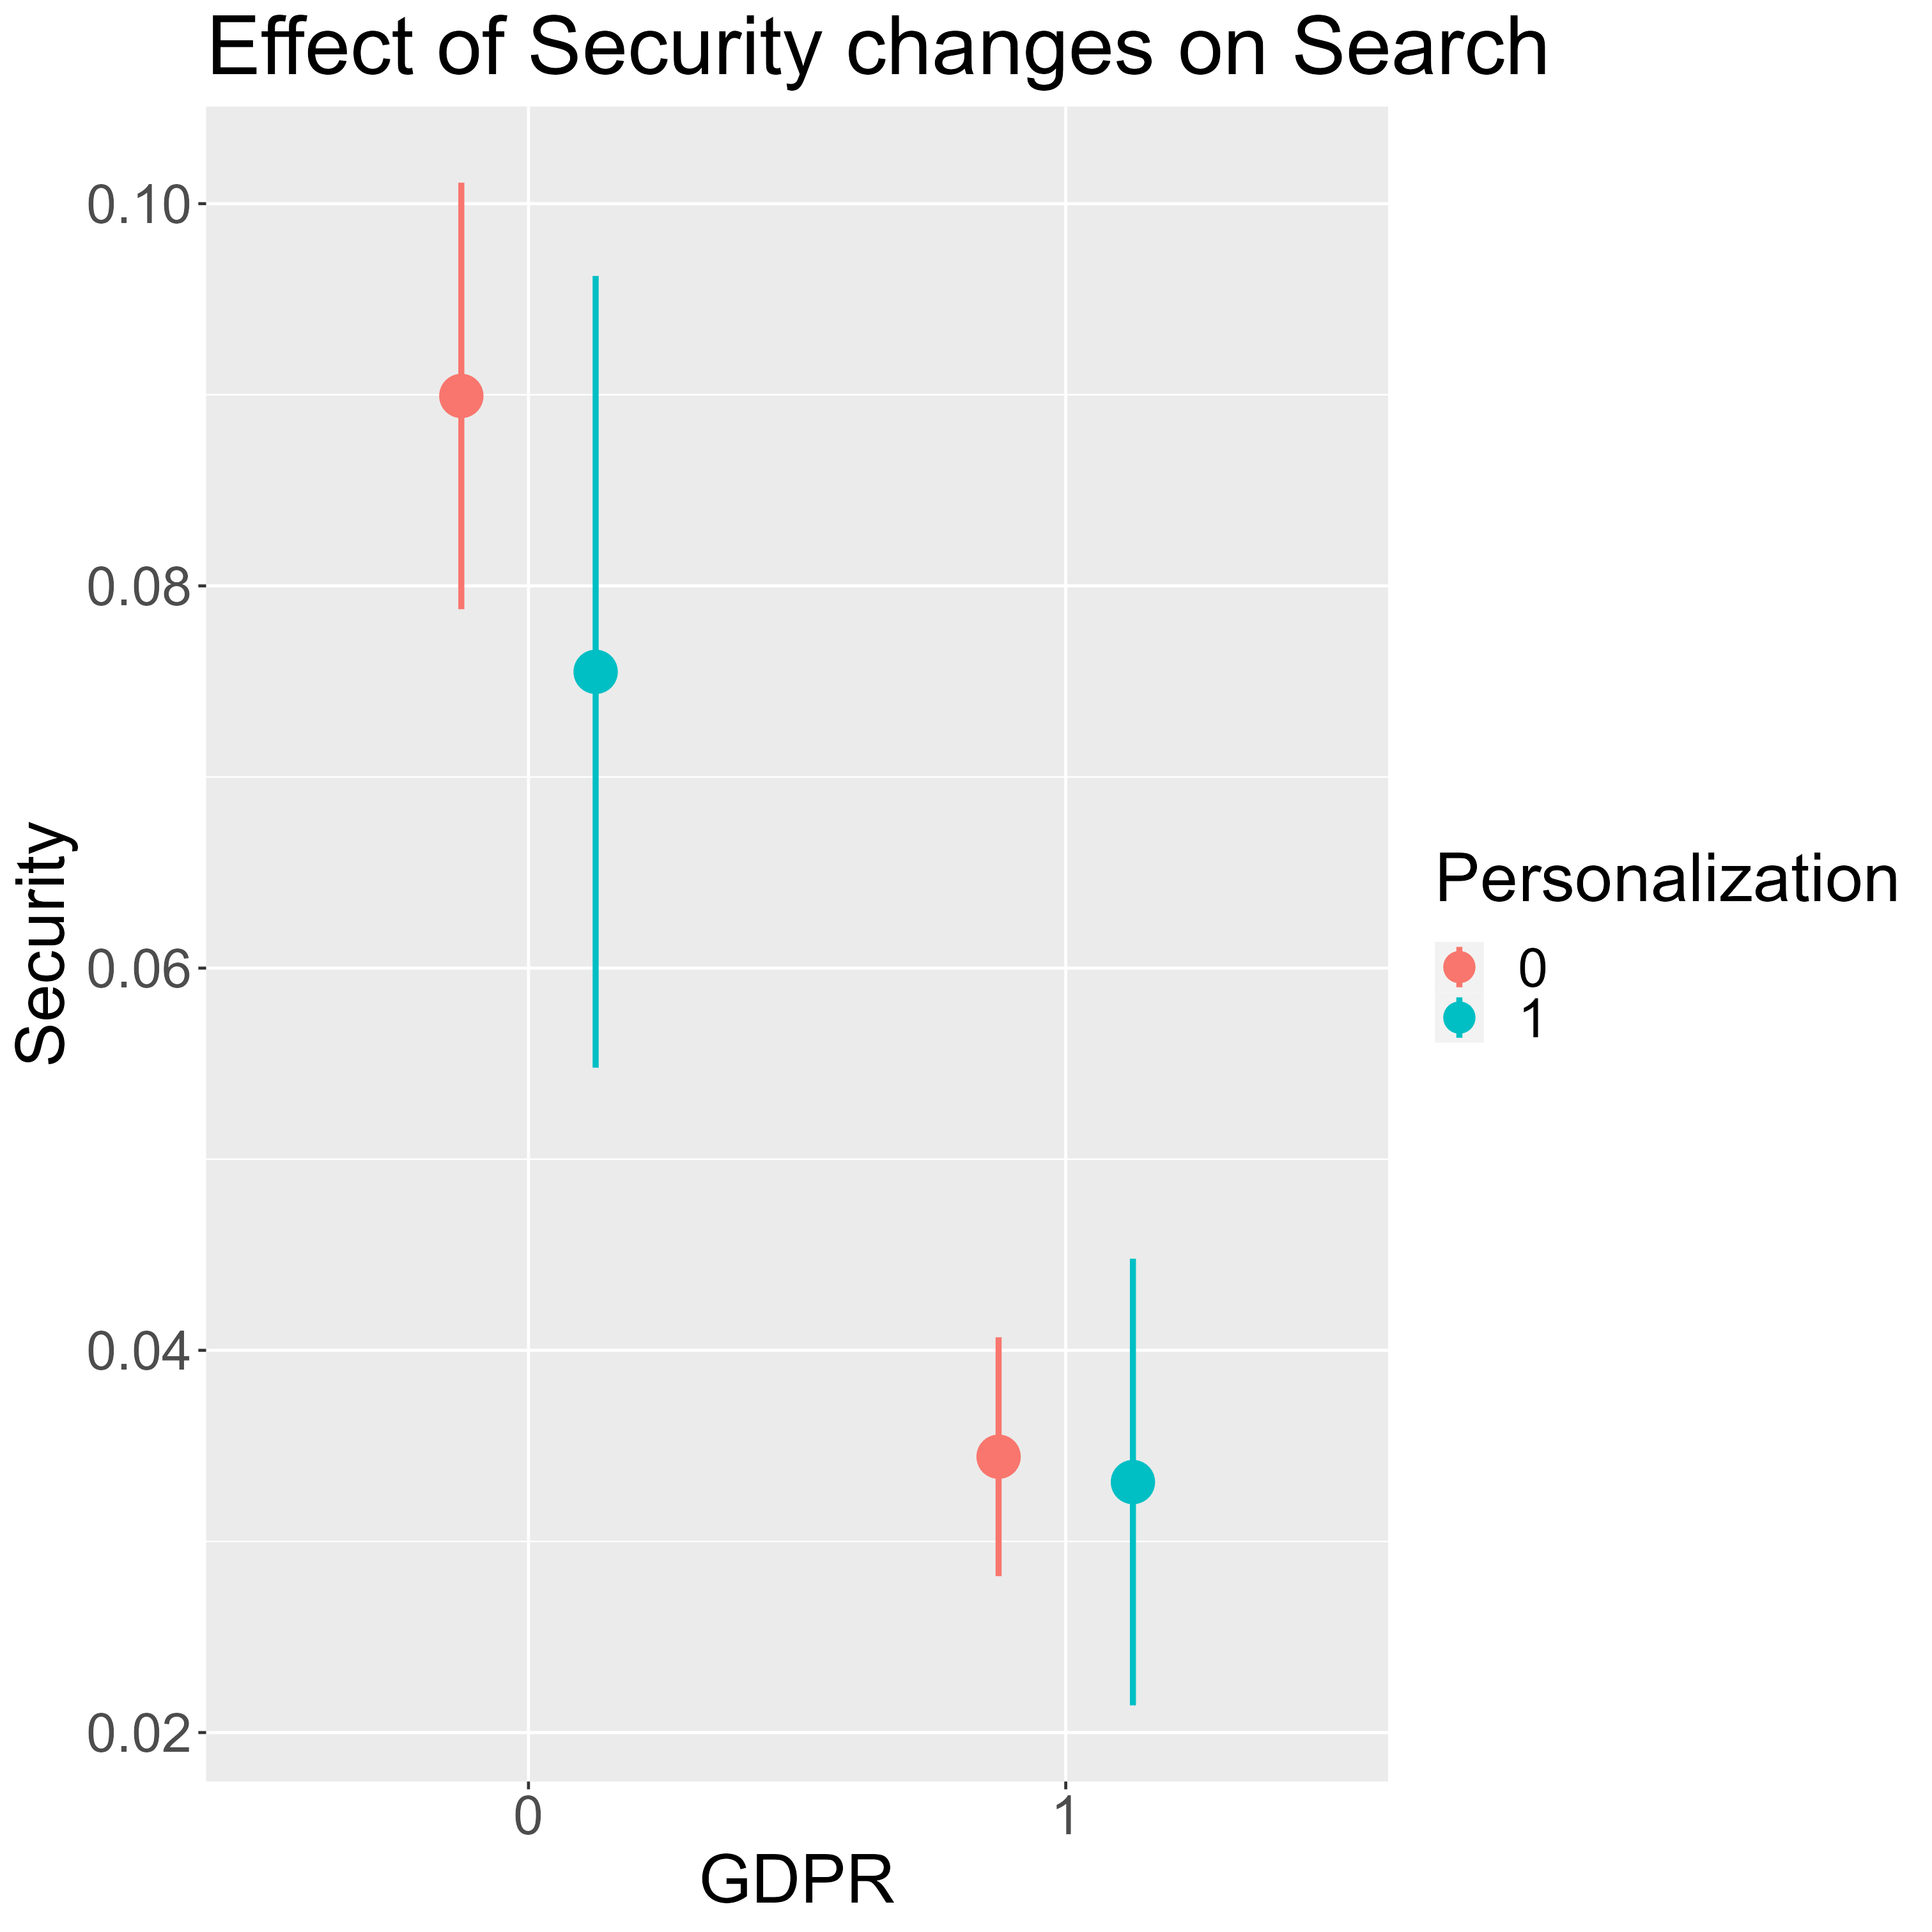
Search
The magnitude of changes induced by security features on search is smaller for personalized apps. However, it is because, before GDPR, the positive effect of security changes on app search for personalized apps was already smaller than that of non-personalized apps.
Notes:
To better visualize our previous findings, we can look at each outcome more closely.

Slide 69
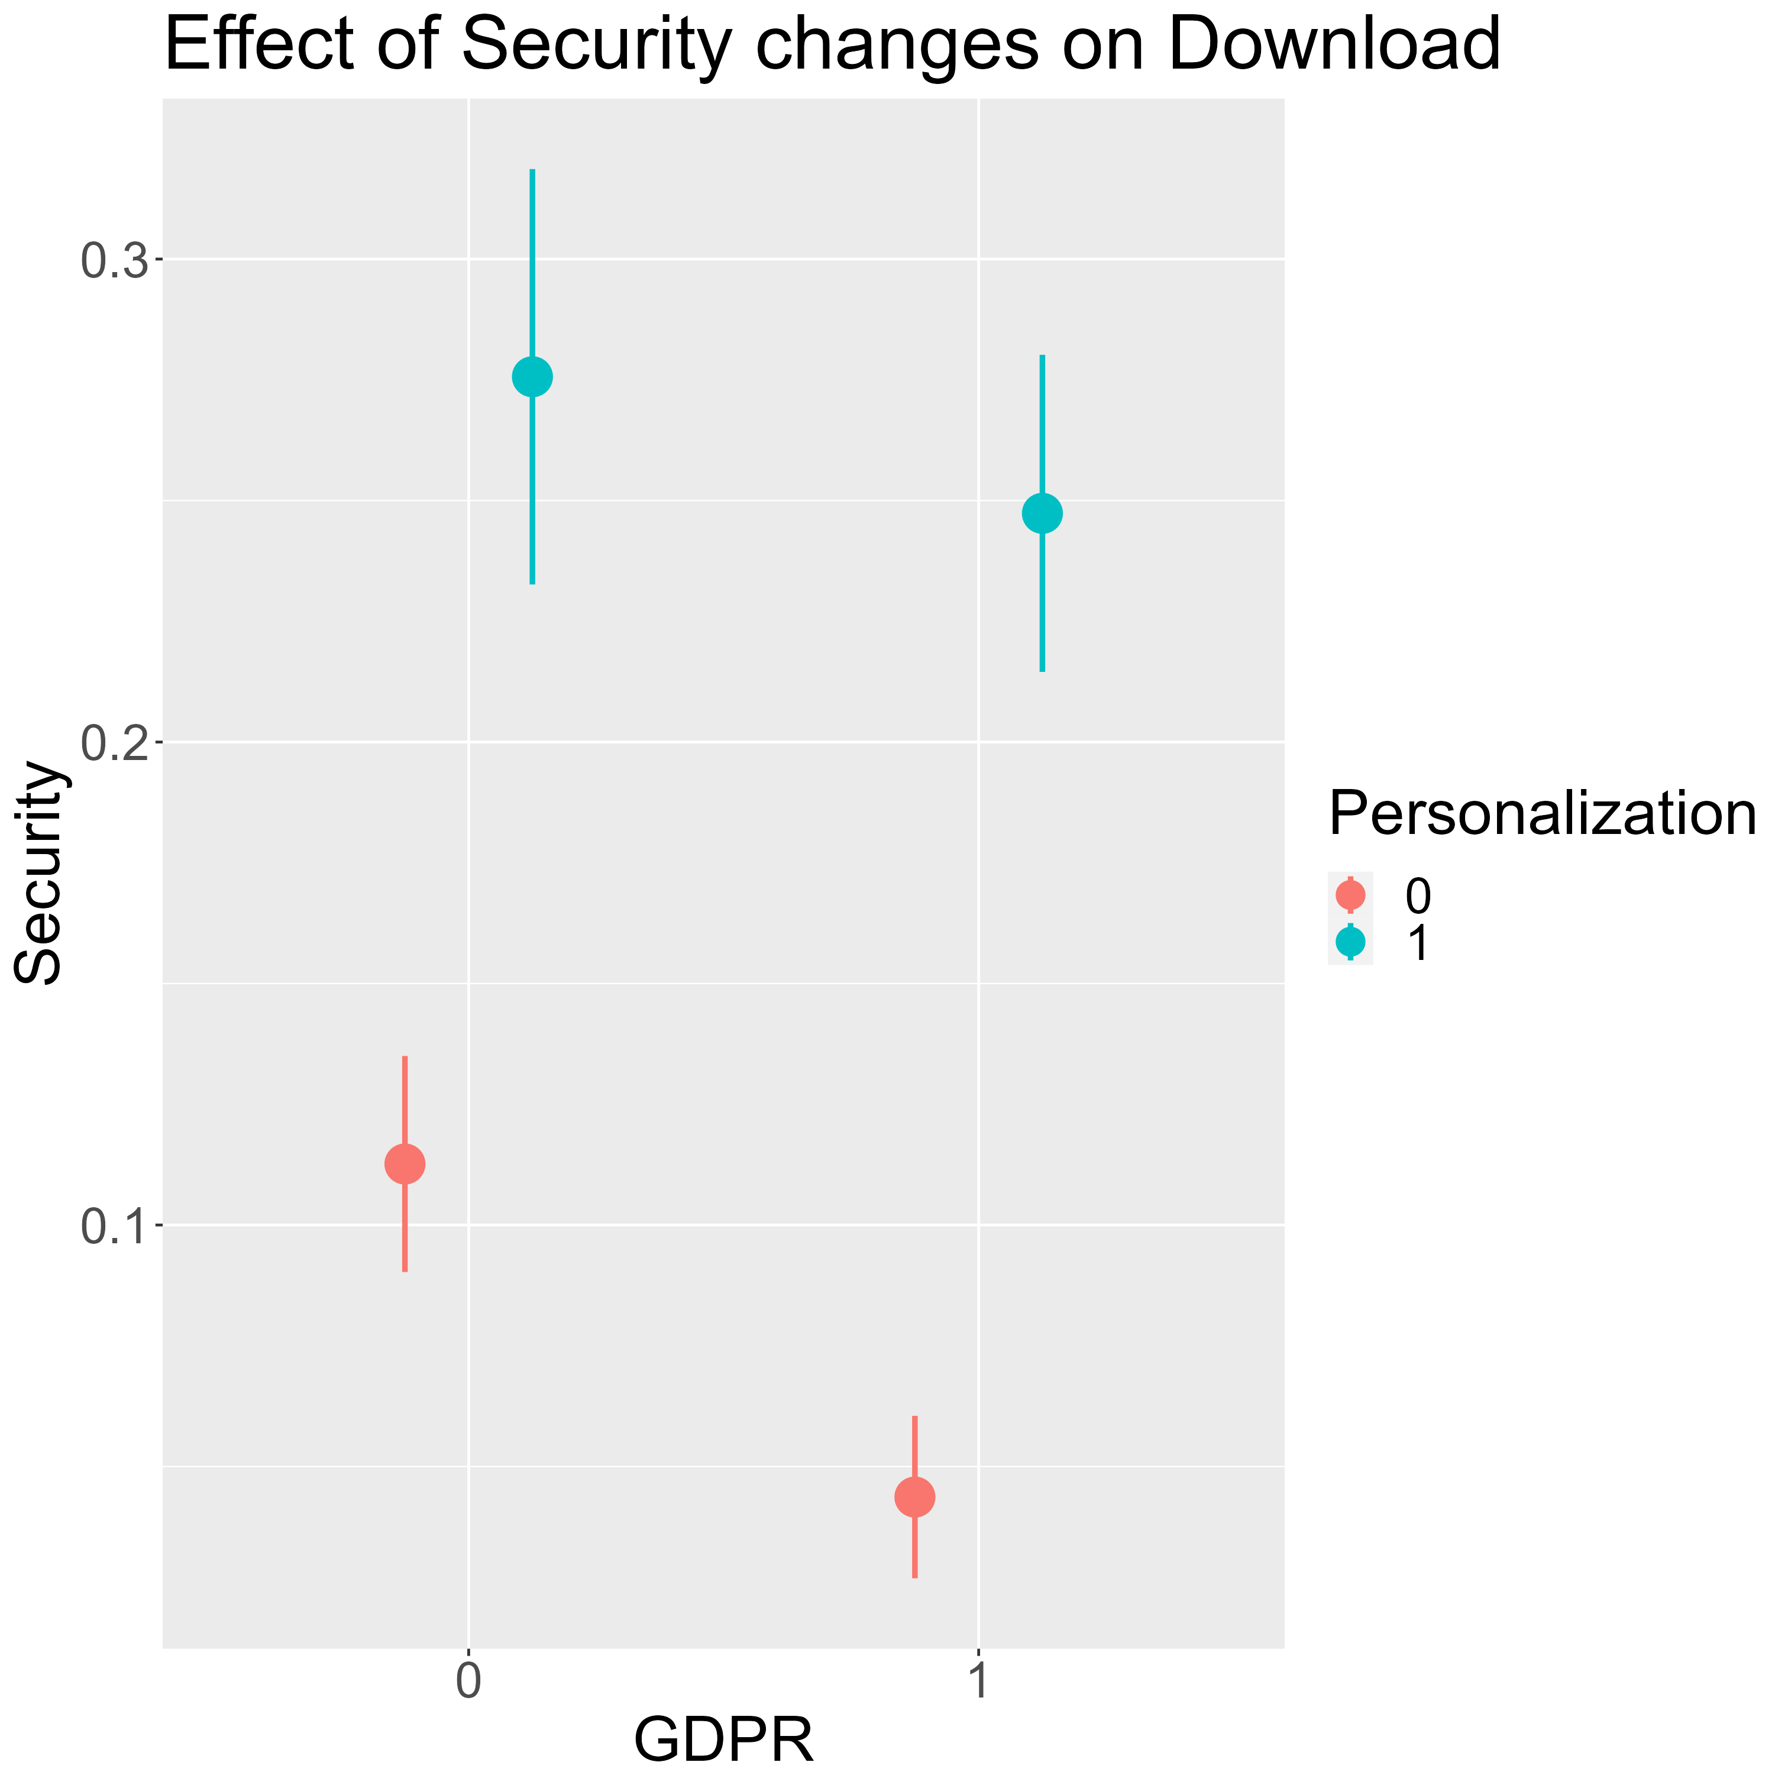
Download
The negative impact of GPDR is smaller for personalized apps than that for non-personalized apps

Slide 70
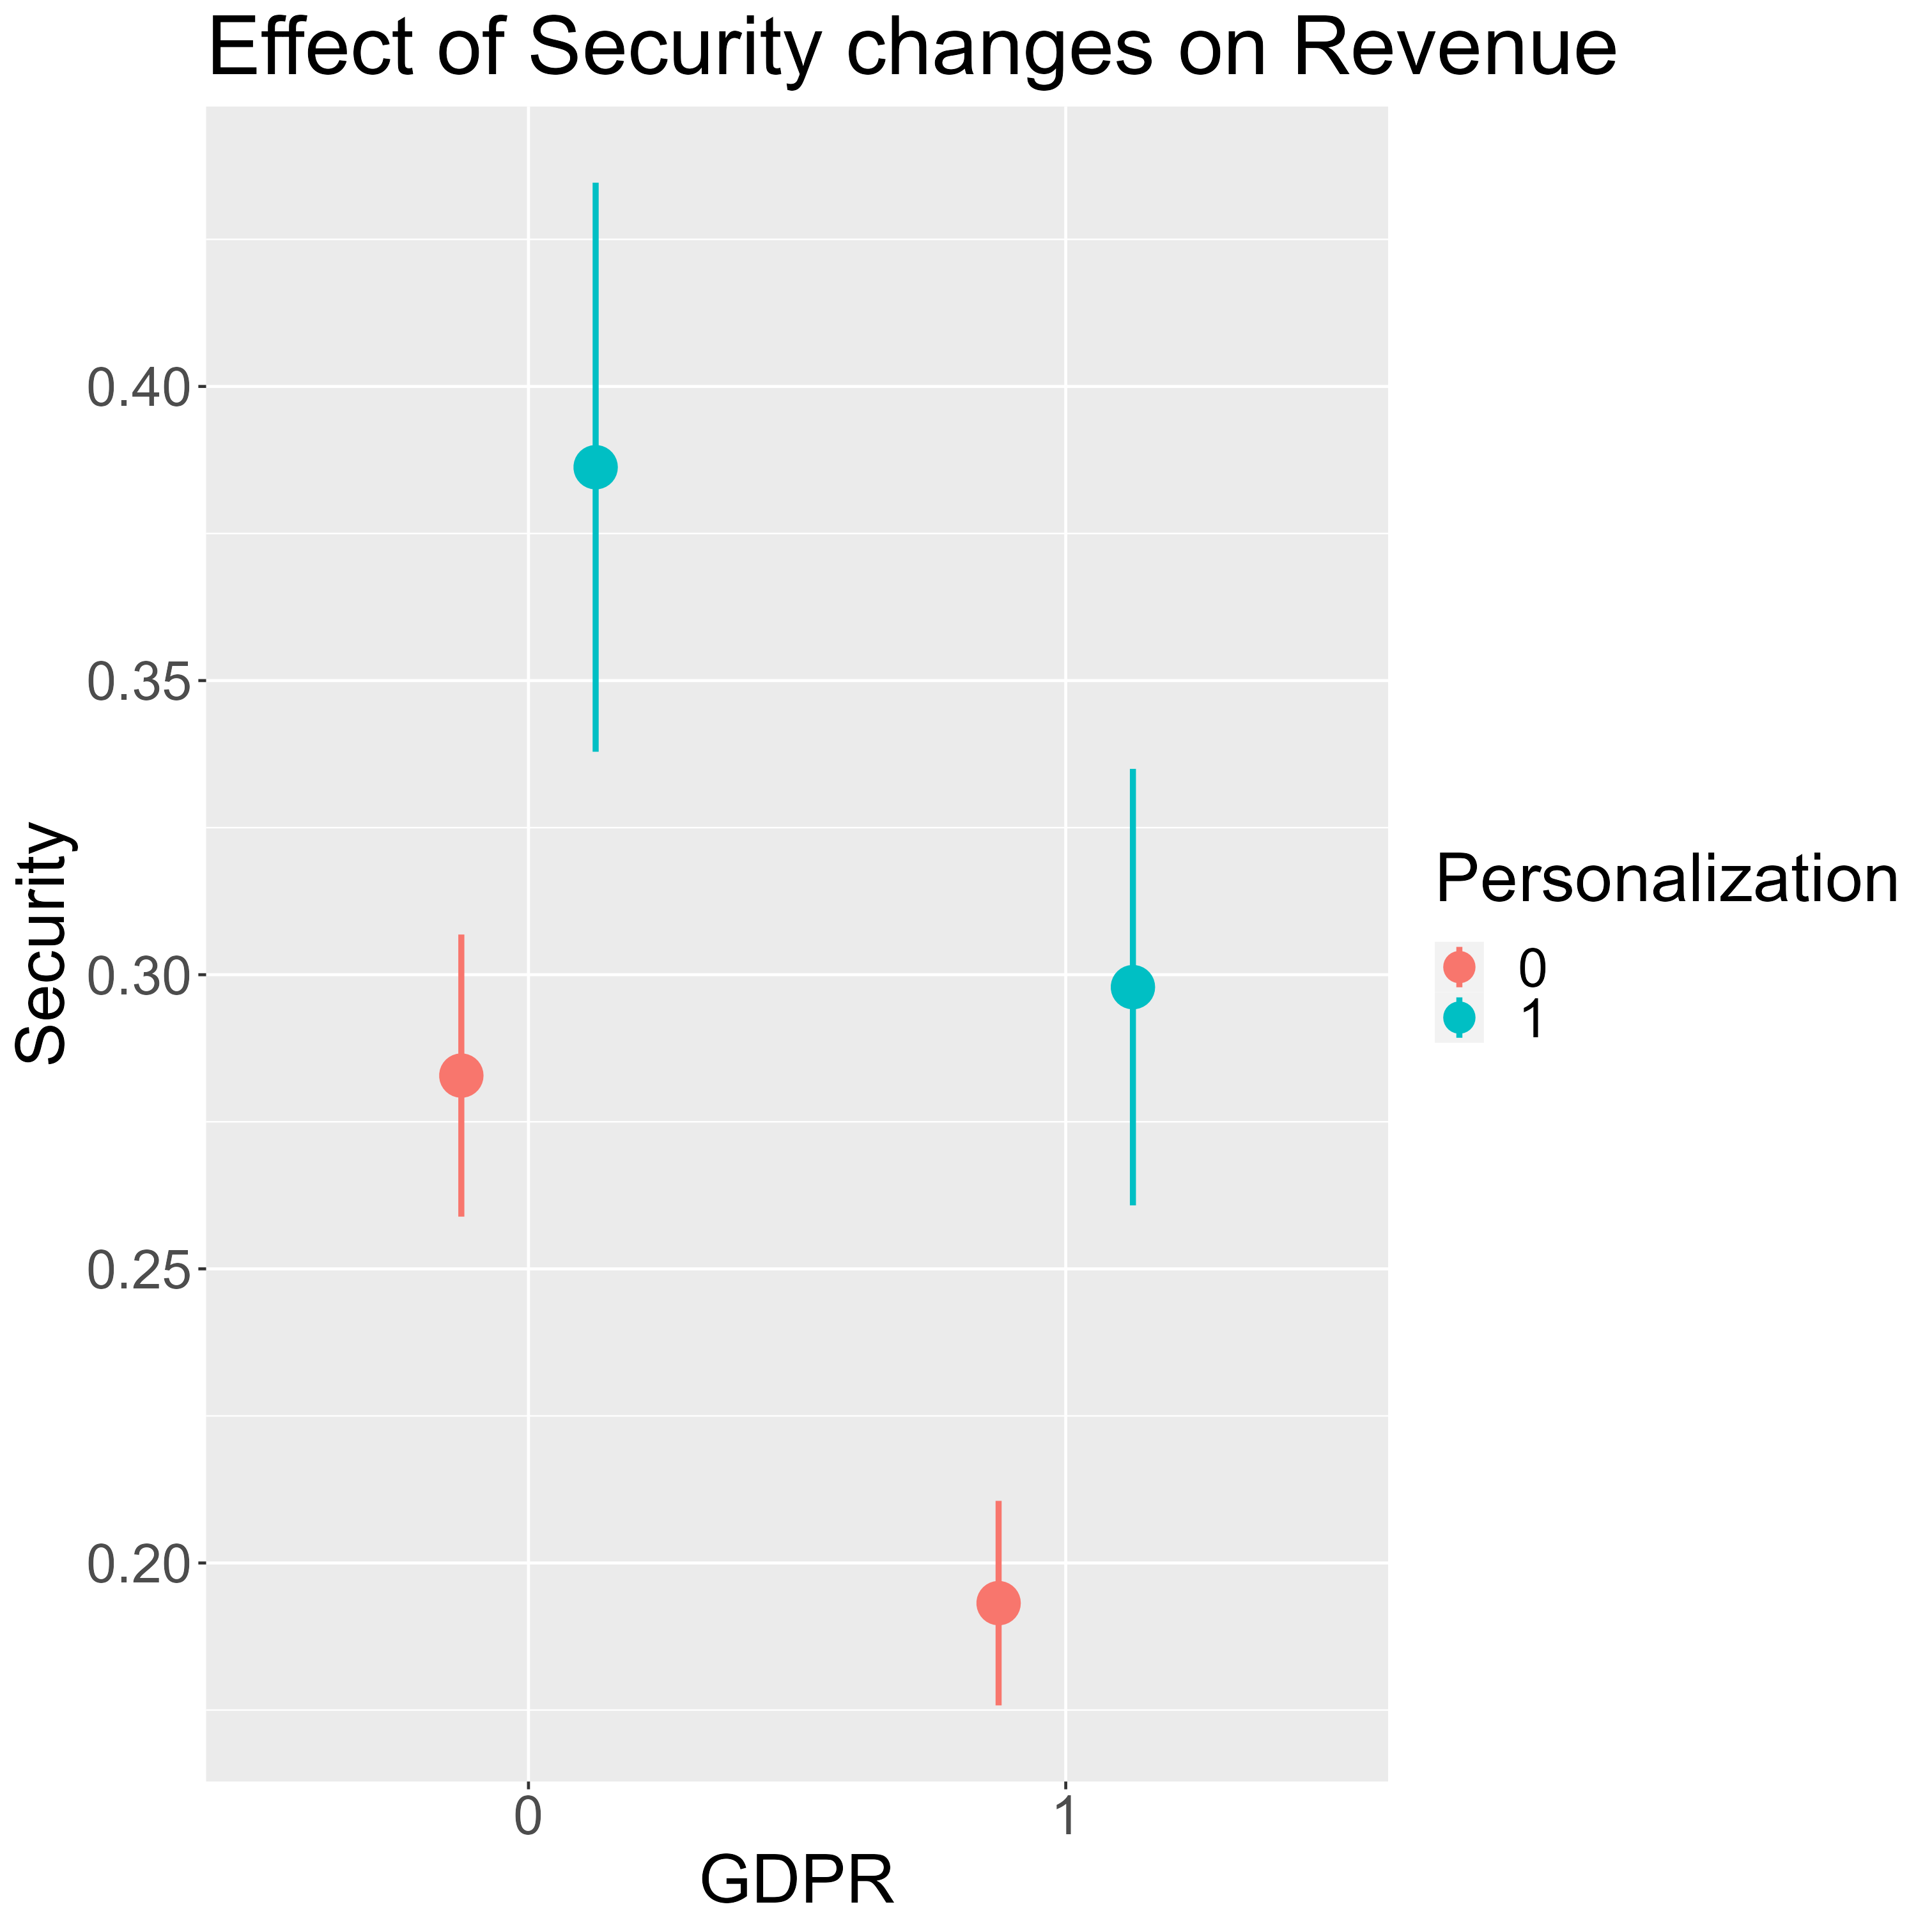
Revenue
There is no impact of personalization on the negative impact of GDPR on the relationship between security and revenue
Notes:
Think why revenue, rating, and reviews are consistent while download and search are so different.

Slide 71
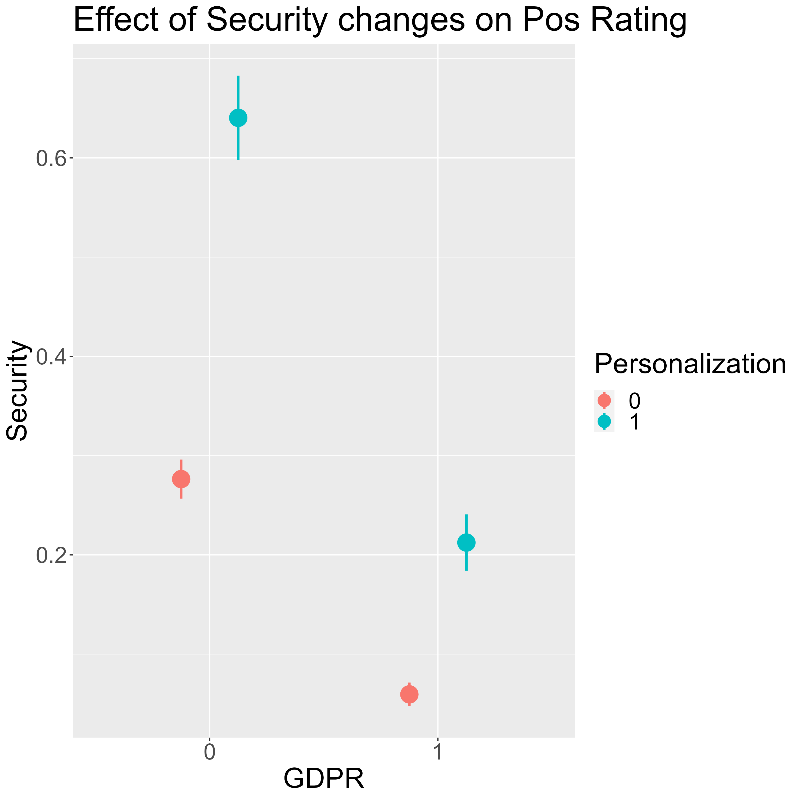
Rating
Rating for personalized apps suffer more after GPDR

Slide 72
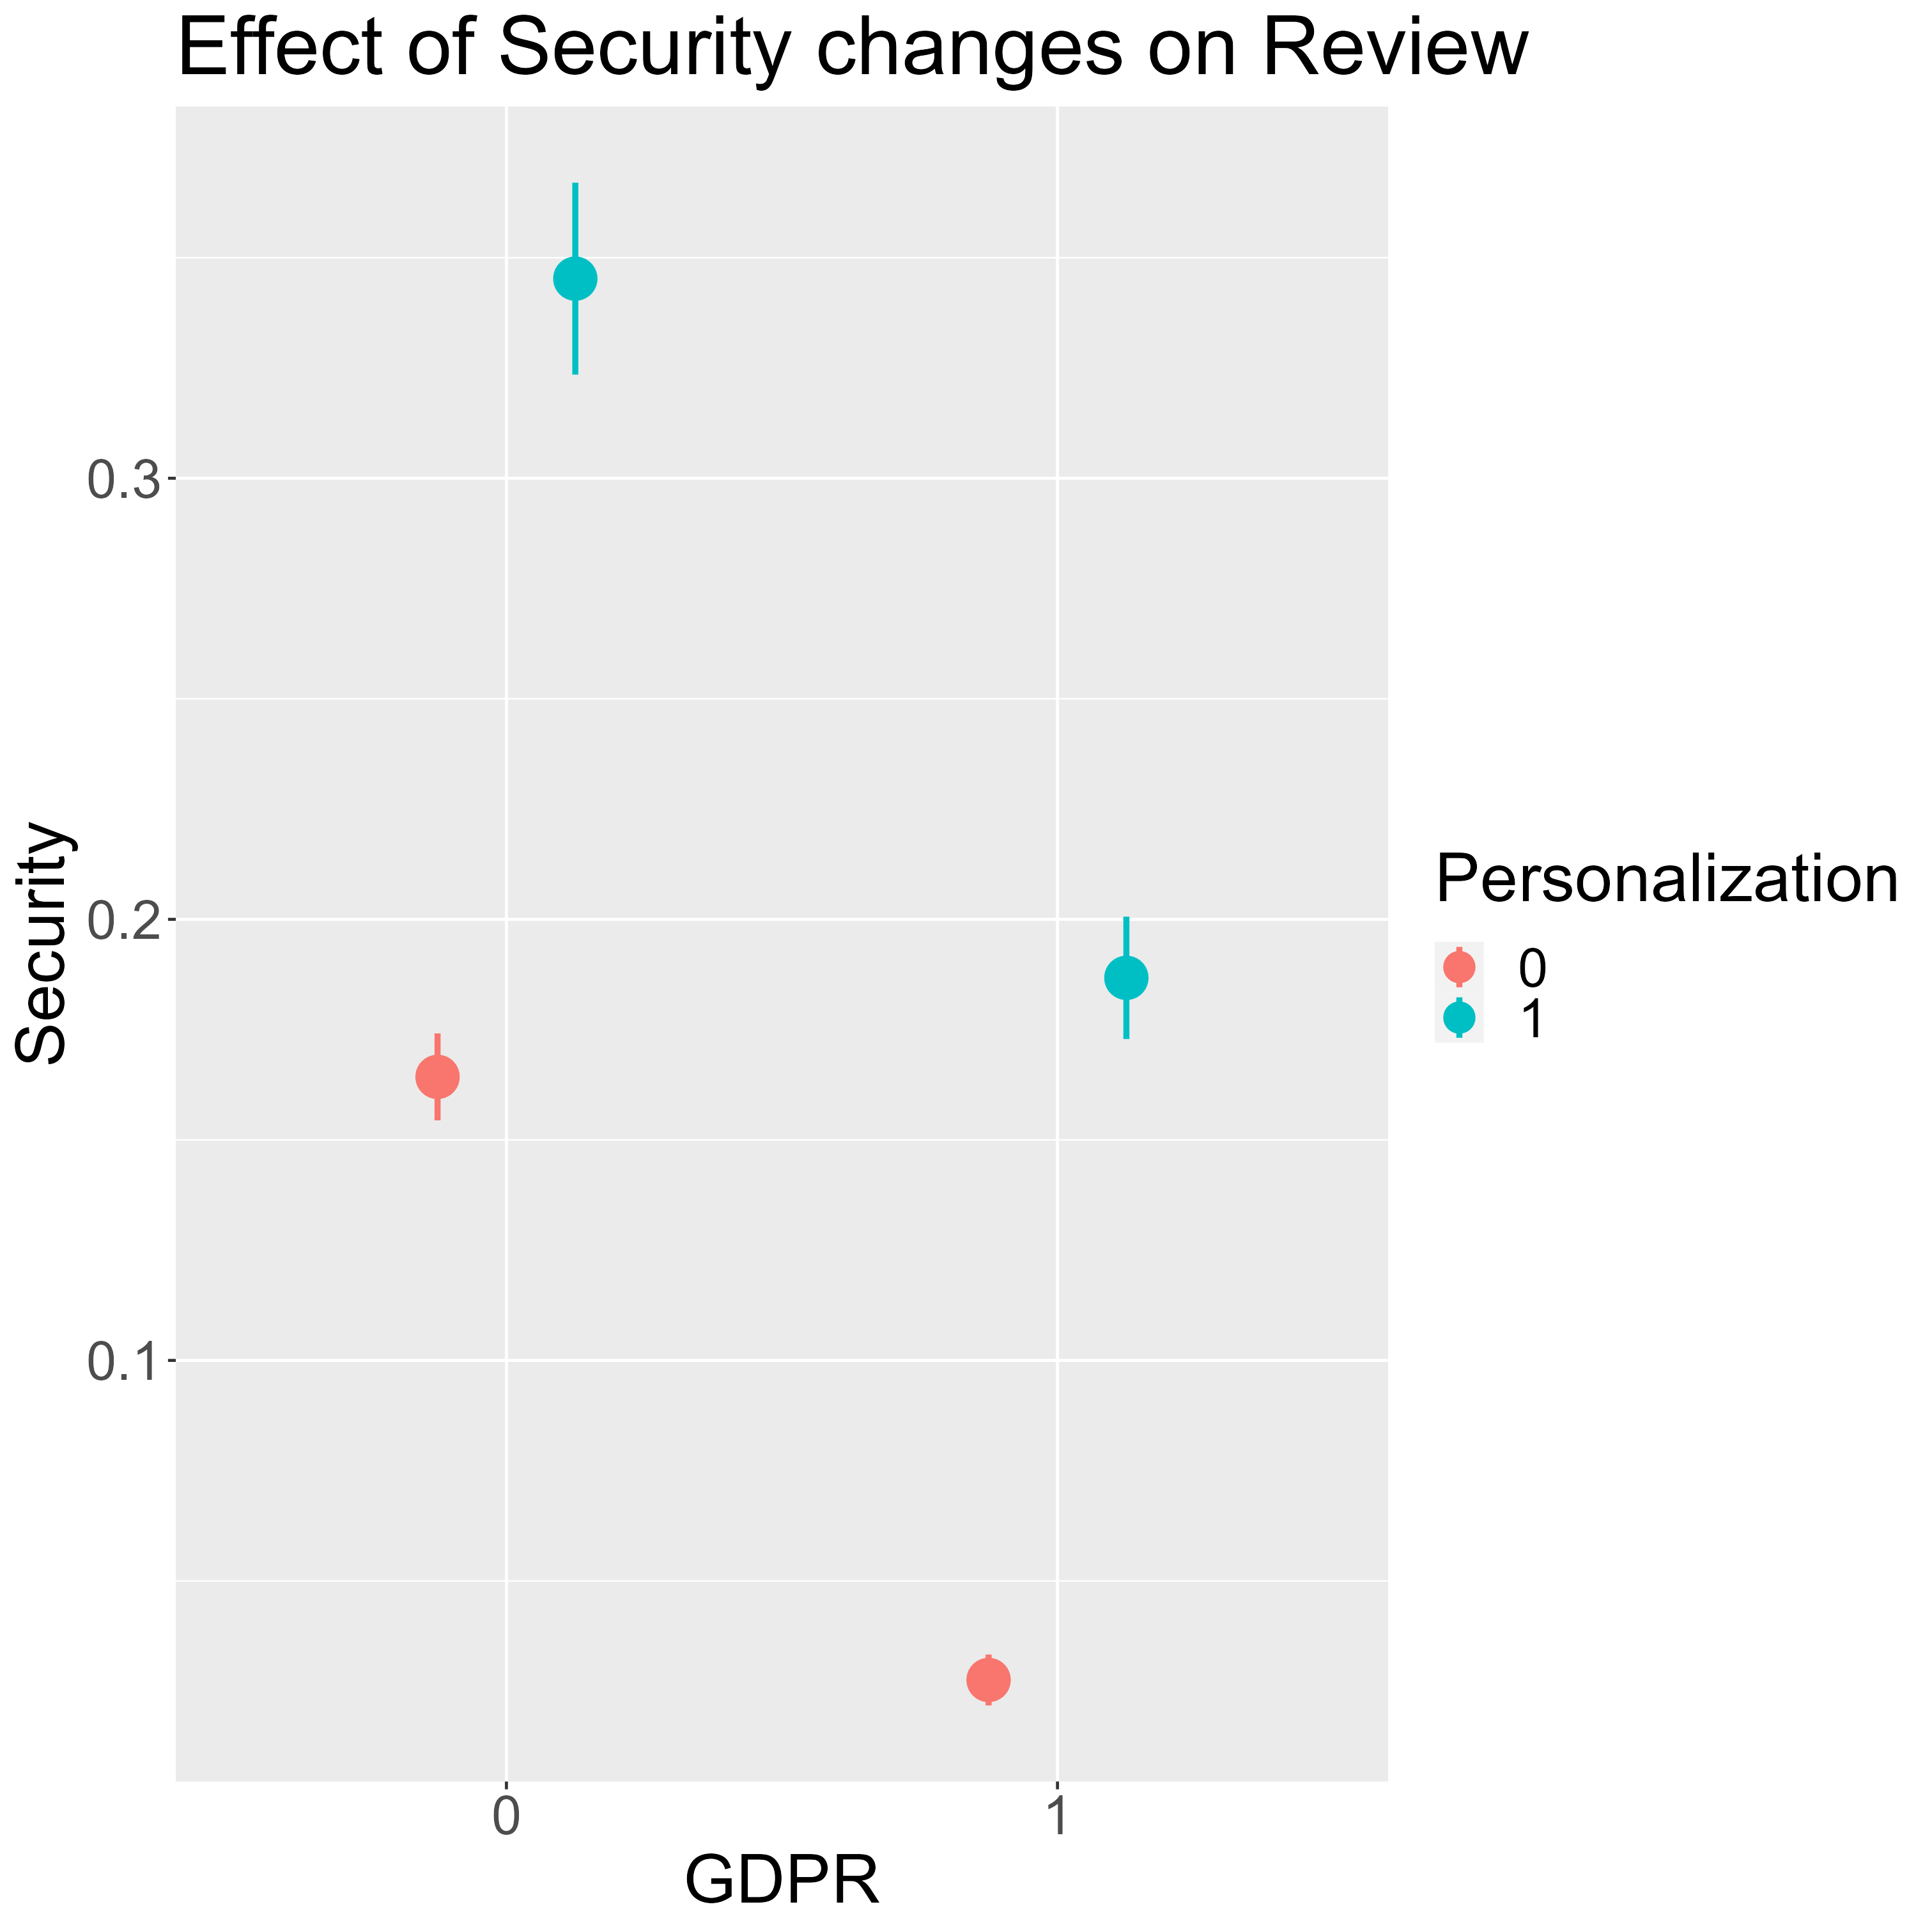
Review
Similar to revenue, here is no impact of personalization on the negative impact of GDPR on the relationship between security and review

Slide 73
Summary - Personalization
Pre-purchase
Purchase
Post-purchase
Notes:
When thinking about the effect of personalization on the 2-way interaction between app security, GDPR and app outcomes, it can be easier to think about app desirable outcomes as three stages (pre-purchase, purchase, and post-purchase)
For the pre-purchase outcomes, it seems like customers appreciate more features (i.e., more personalization for their apps that are tailored to their interests).
However, consumers stop considering personalization in their purchase stage.
While in the post-purchase stage, they realize how important privacy is to them, and knowing that personalization requires more data from them, they might punish apps for having personalized features.

